Slide 1
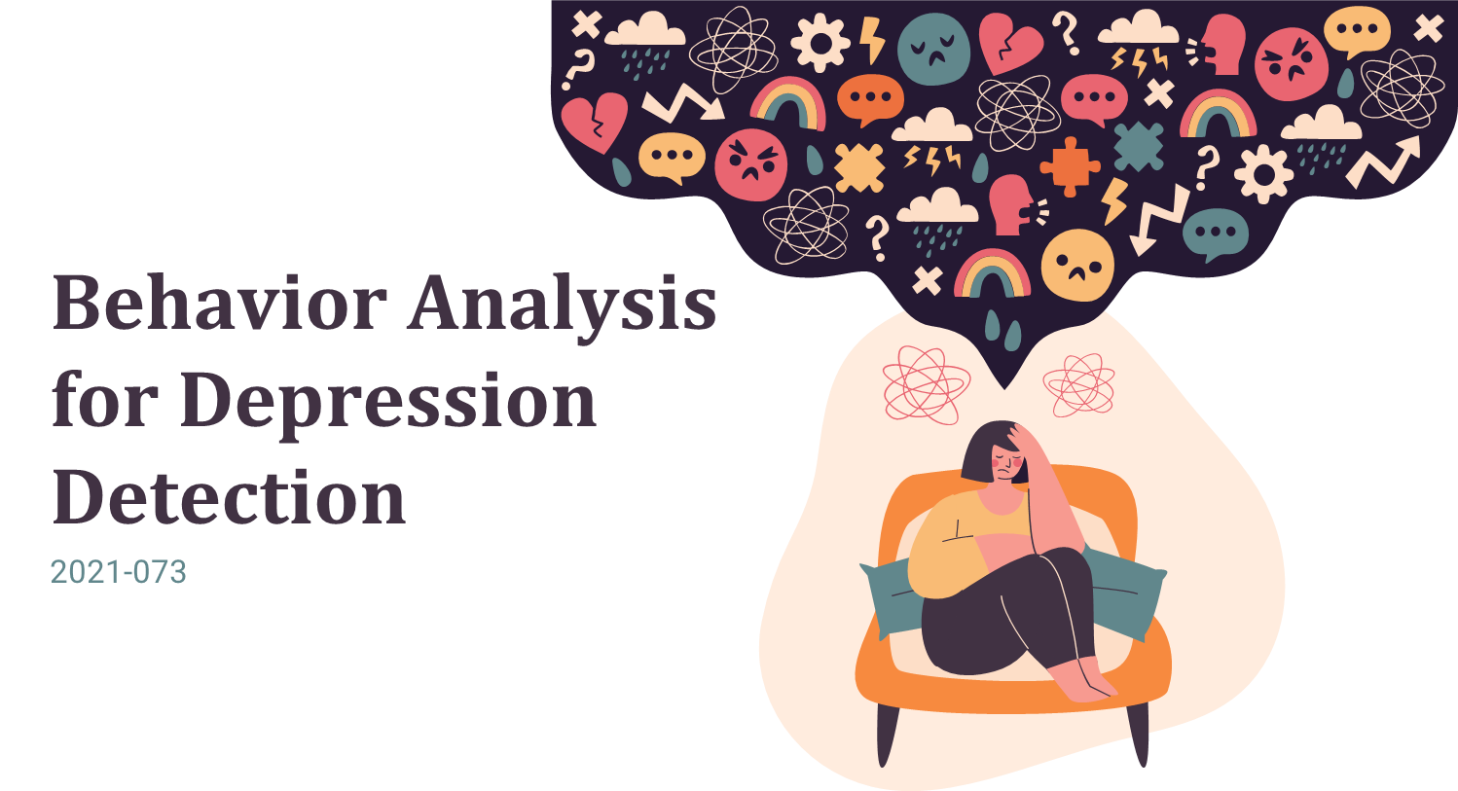


Slide 2


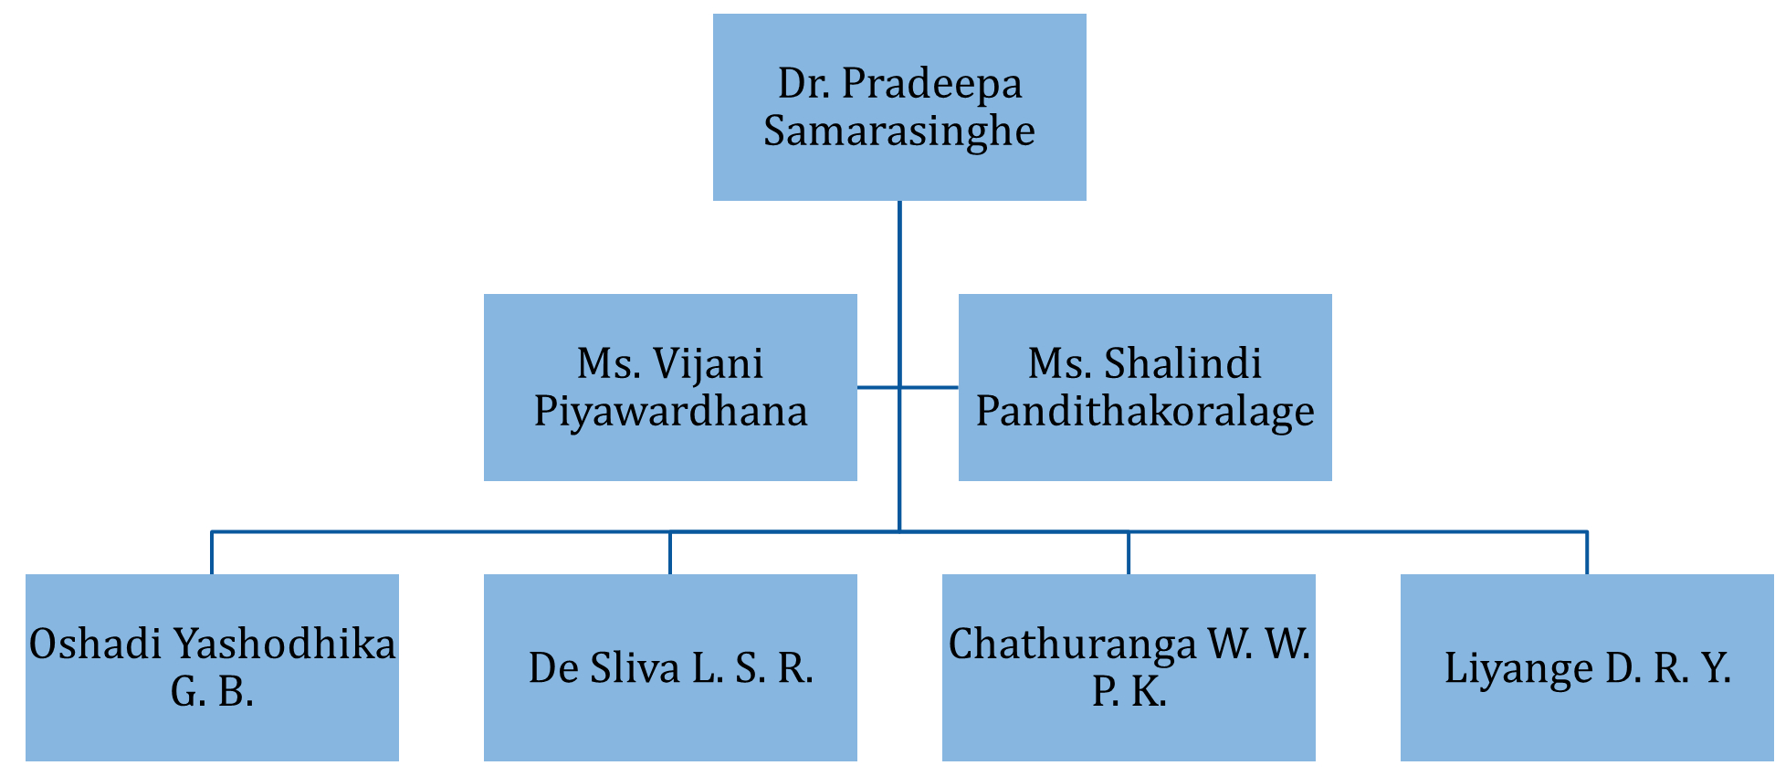

OUR TEAM

Slide 3

Depression ?
A recurrent mental disorder affecting more than 264 million people worldwide (World Health Organization).
Globally, depression has become the most common reason for illness and disability among adolescents
Early signs of severe depression are necessary to identify and ensure the affected person obtains immediate medical assistant.

Slide 4
Depression? (Cont’d)
Psychotherapy determines depression levels based on verbal reports that may bias the diverse aspects of individuals.
Currently, the mobile applications associated with depression use standard questionnaires and self assessment reports to evaluate the depression level.

Slide 5

Research Question
Why depression has become the most critical disorder?
People are not receiving adequate treatments, which may lead to suicide.
What is the main reason people tend to avoid treatment for depression in Sri Lanka?
In Sri Lanka, people may obscure the state of their minds due to social stigma and fear.

Slide 6
Research Question (Cont’d)
What is the primary concern of mental health providers?
Mental health providers have problems with monitoring of individuals for two weeks.
Why the industry need an automate solution to assess the depression?
Periodic assessment based on structured or unstructured clinical interviews may bias the different aspects of individuals.

Slide 7

Objectives
Emotion-based behavior analysis for early identification of depressive disorder.
social media content analysis for early identification of depressive disorder.
Develop a mobile application to identify behaviors that could be highly anticipated to contribute in depressive disorder.
Acquire invasive and non-invasive data analysis for early identification of depressive disorder.
Obtain phone activity usage data analysis for early identification of depressive disorder.

Slide 8
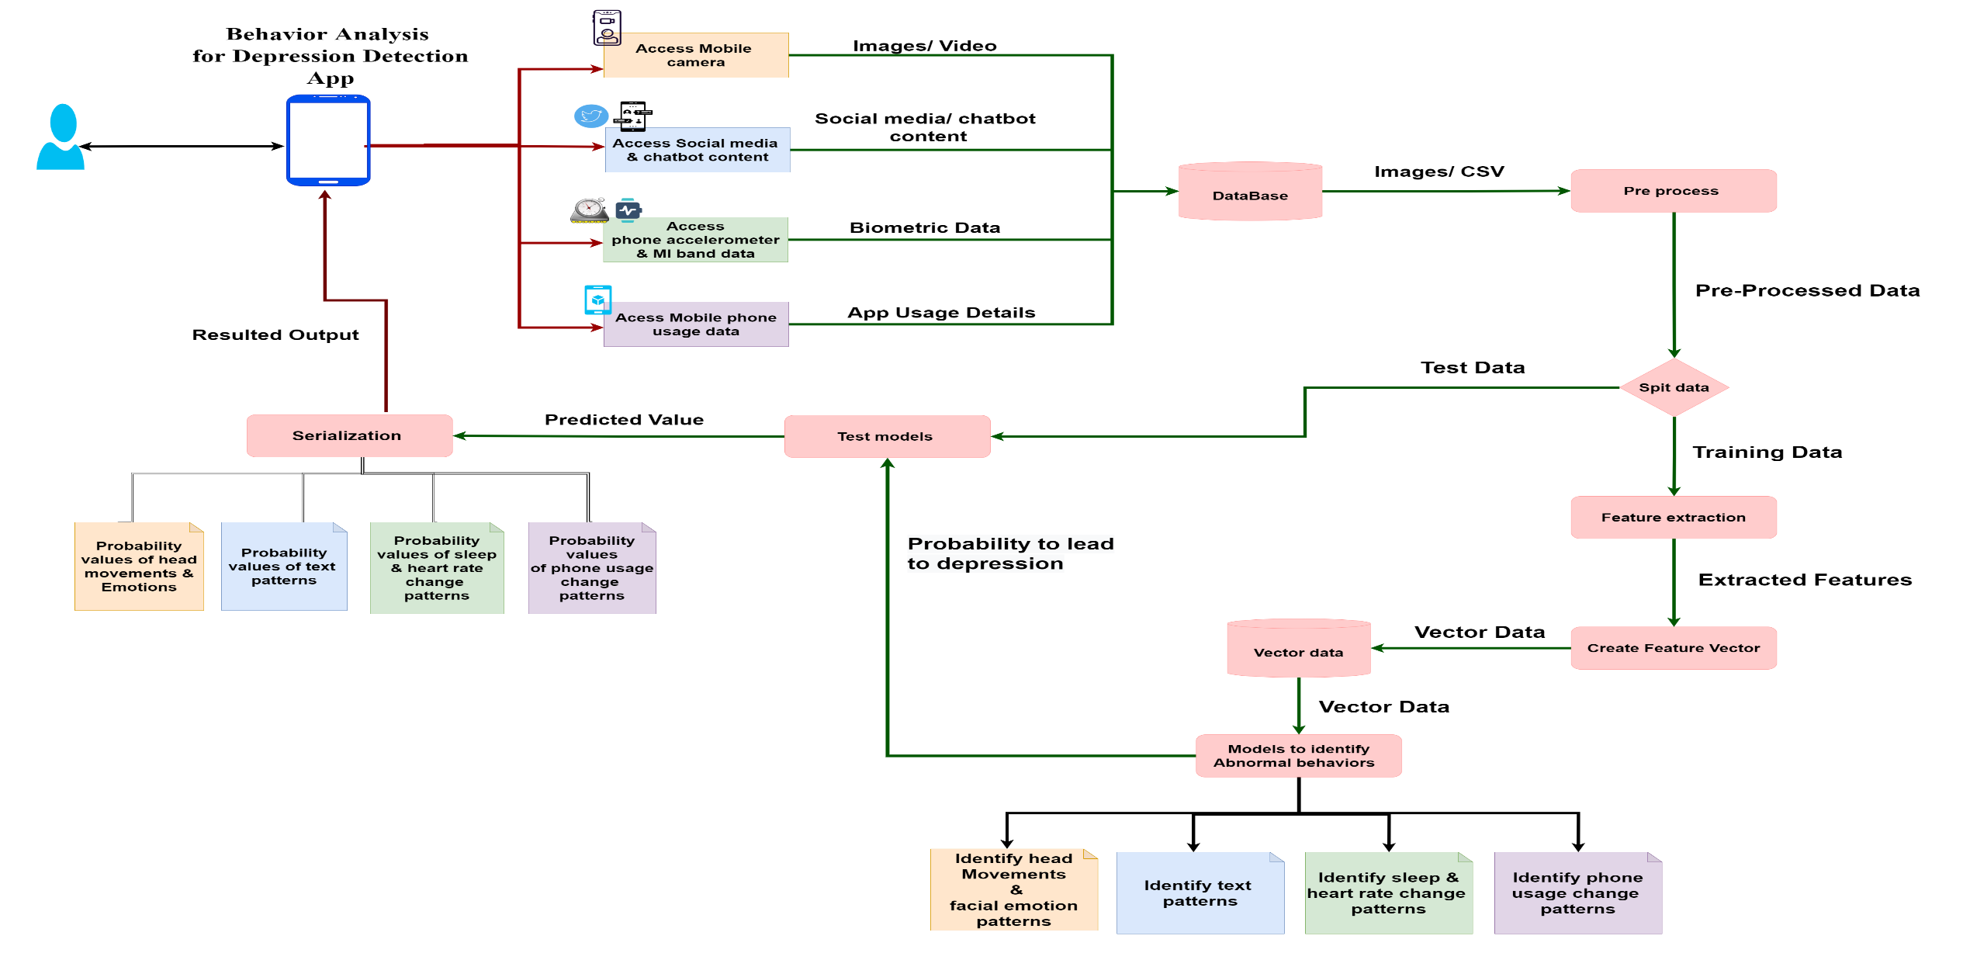
Overall System Diagram

Slide 9


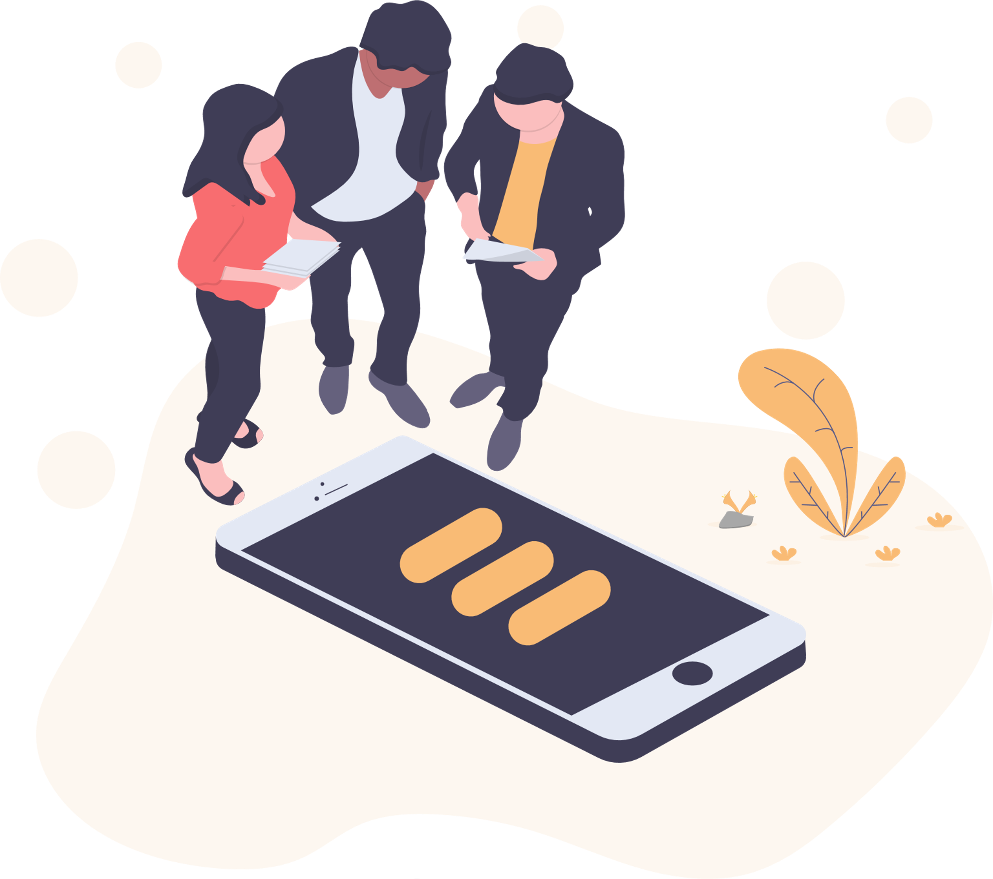





Technologies, Techniques, Algorithms
Mobile App Development
Flutter
Dart
Development Language
Python
Database
Firebase
Environment / IDE
Anaconda 3
Visual Studio Code
Spyder
Android Studio

Slide 10
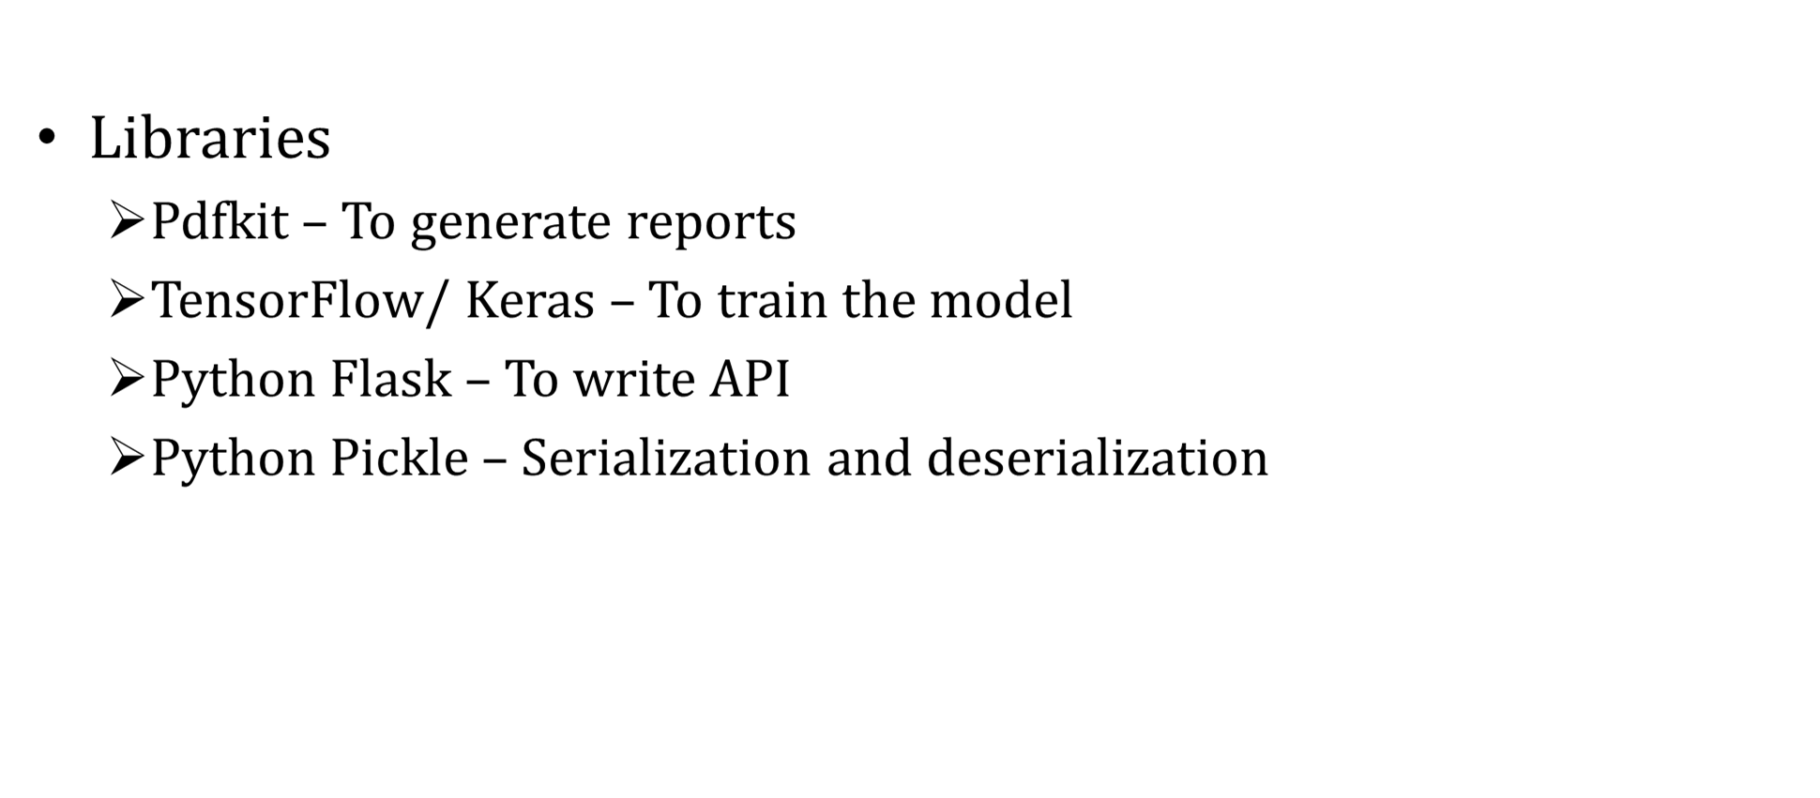
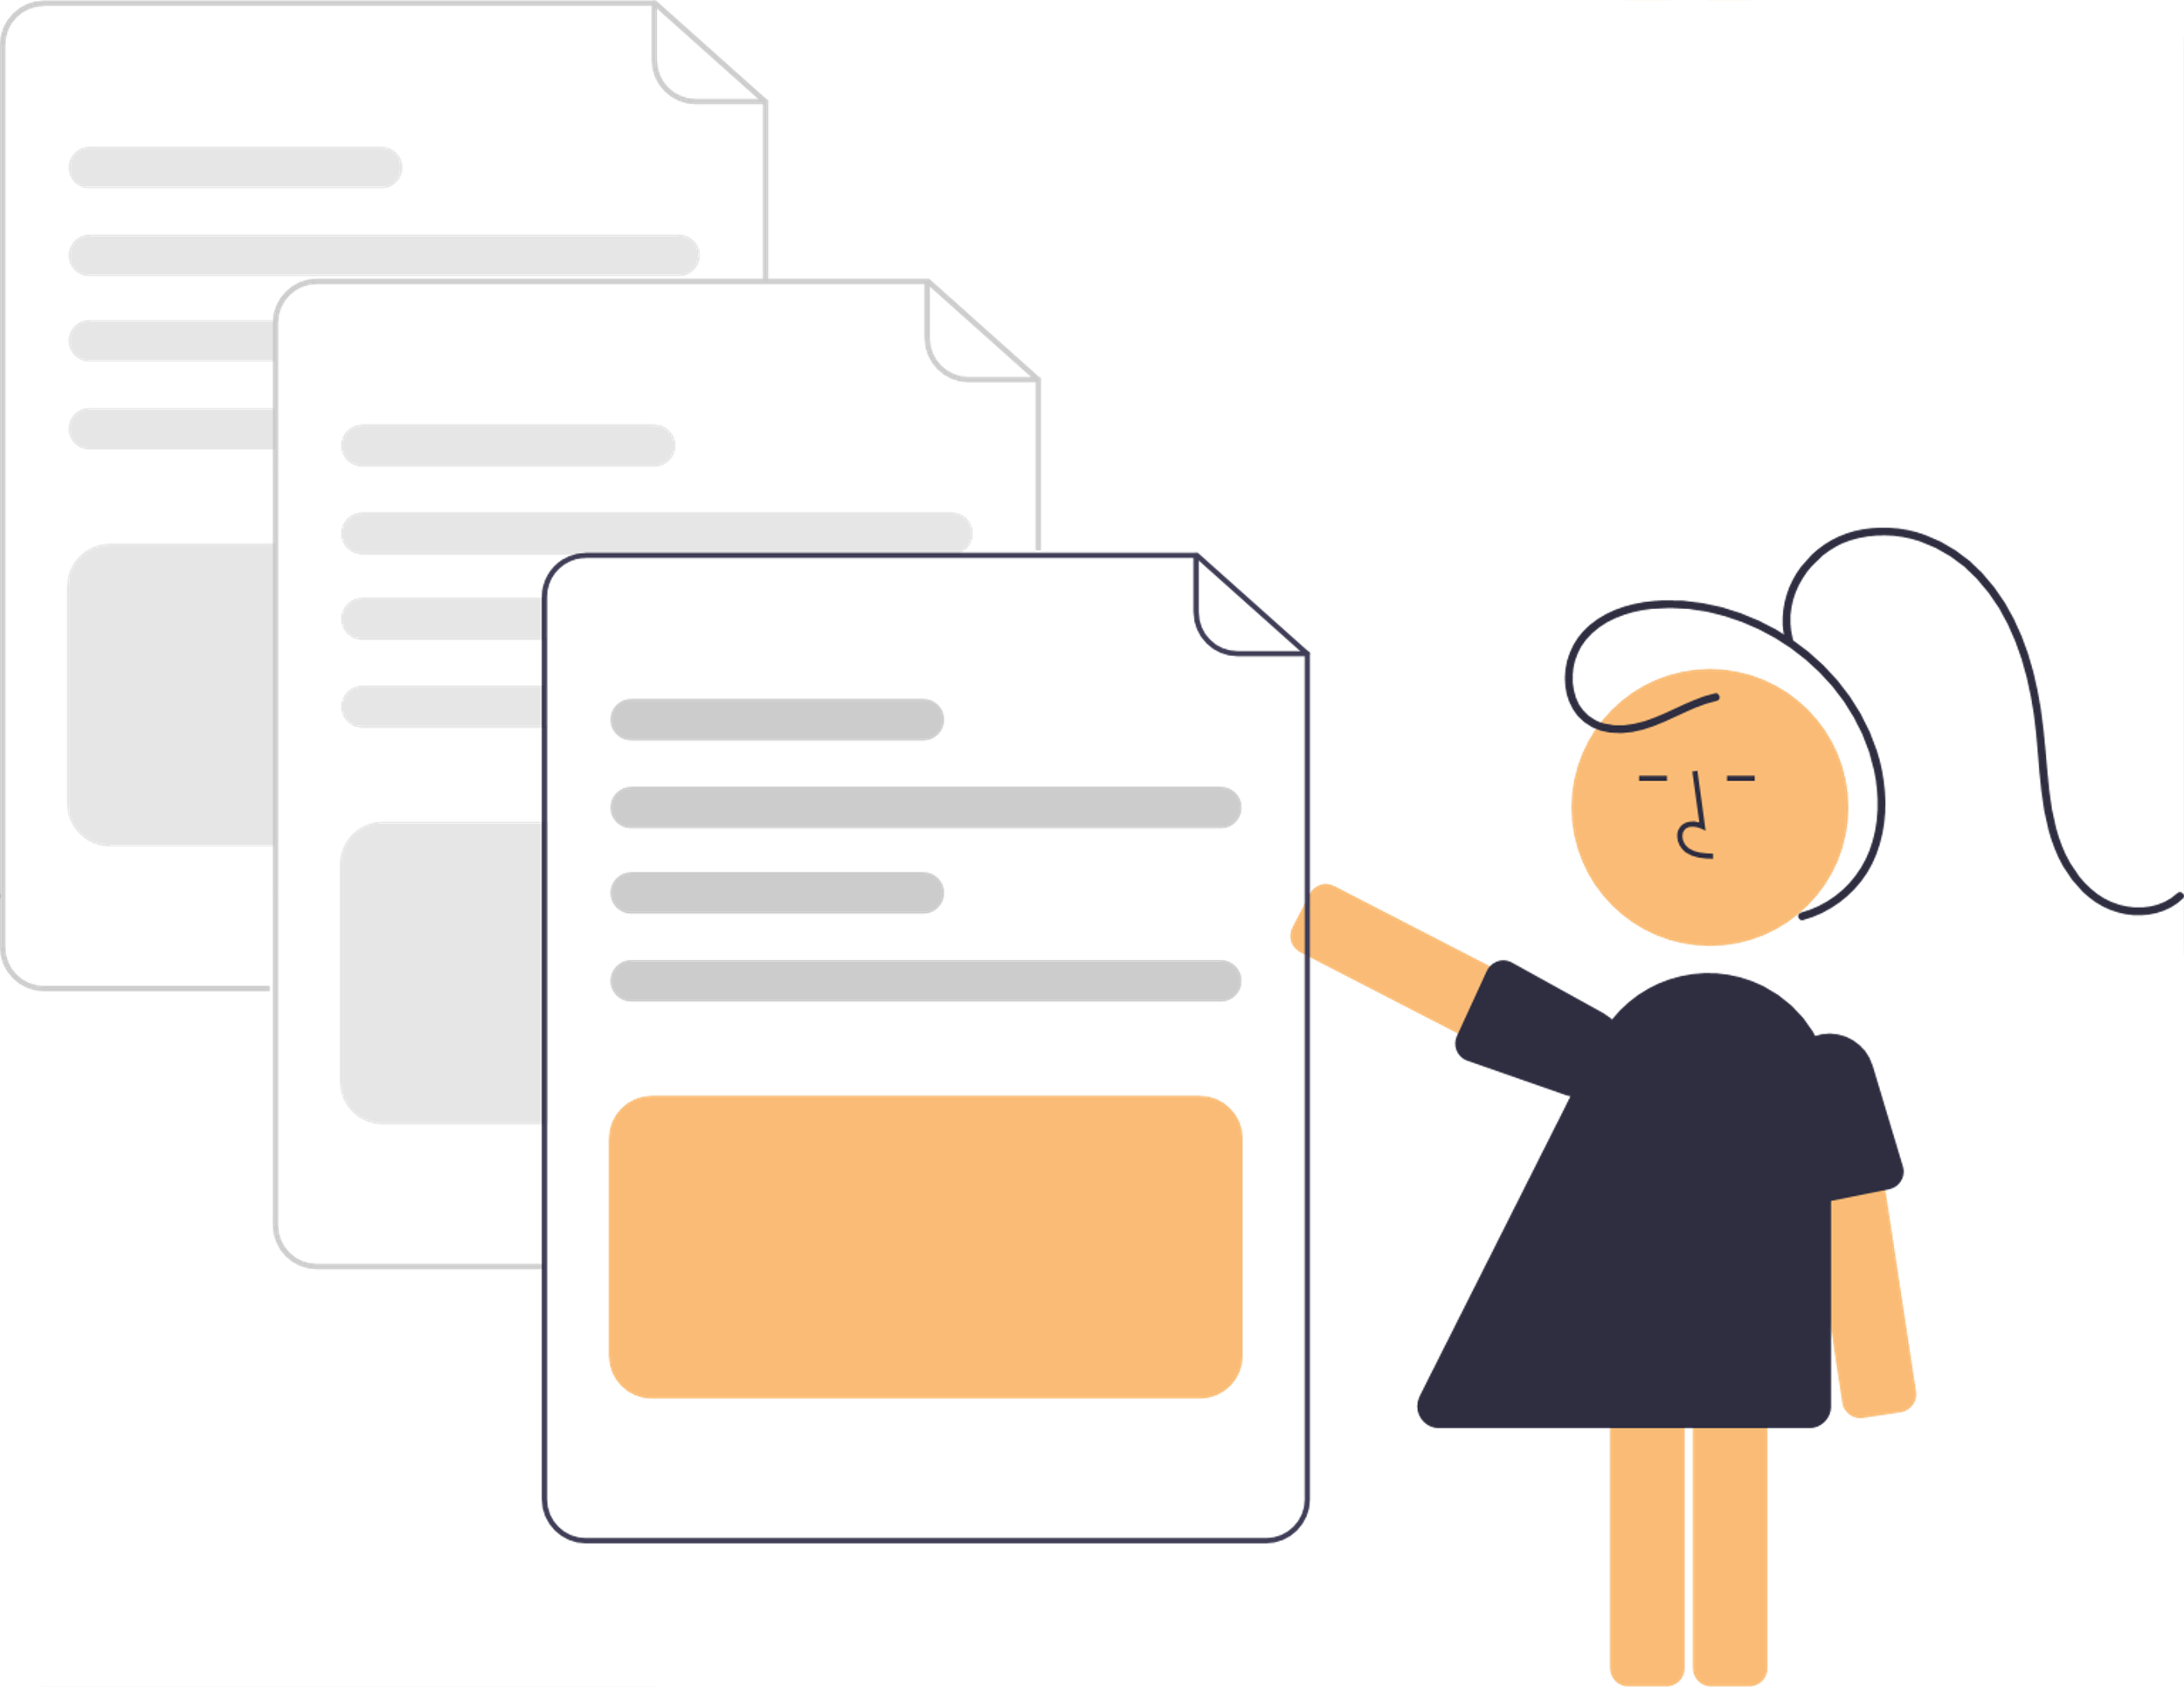
Technologies, Techniques, Algorithms (Cont’d)

Slide 11
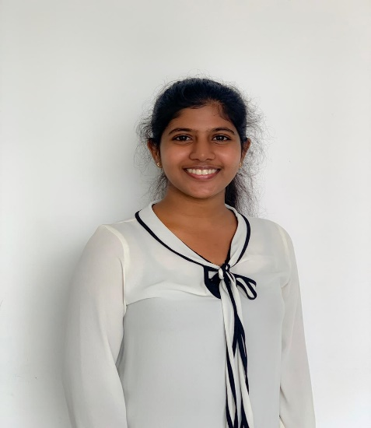

It18120226 | Oshadi Yashodhika g. b.
Information Technology
IT18120226 | Oshadi Yashodhika G. B. | 2021-073

Slide 12

EMOTION-BASED BEHAVIOR ANALYSIS FOR EARLY IDENTIFICATION OF DEPRESSIVE DISORDER
Research Question
Specific and Sub Objectives
Evidences for the Completion
IT18120226 | Oshadi Yashodhika G. B. | 2021-073

Slide 13
Research Question
Lack the automated solution to identify early depression symptoms using facial expression.
Lack the automated mechanism to identify head movement patterns of a depressed individual.
Behavior monitoring of individuals for two weeks is difficult.
Individuals do not attend counseling sessions due to social stigma.
IT18120226 | Oshadi Yashodhika G. B. | 2021-073

Slide 14



Specific and Sub Objectives
Specific Objective
Emotion-based behavior analysis for early identification of depressive disorder
Sub Objectives
Create datasets to retrieve facial emotions of depressed/likely depressed individuals.
Identify emotions of depressed/likely depressed individuals based on images and videos.
Improving the existing methods to capture subtle emotional changes.
Identify head movements pattern of depressed/likely depressed individuals based on videos.
Build a classifier to model, abnormal behaviors based on facial emotions and head movements.
Predict the probability of abnormal behavior towards depression with the designed model.
Integrate the classifier to Mobile Application.
IT18120226 | Oshadi Yashodhika G. B. | 2021-073

Slide 15
Implementation Progress
Data Collection
Data Analysis
Model Implementation and Testing
Mobile App
Implementation
Model Integration with Mobile App
Complete Mobile App
Depression Dataset
Non-Depression Dataset
Data Labeling
Feature Extraction
Emotion Based Model
Head Posture Based Model
Ensemble Model
Interface
Design
Functionality Implementation
Interface Implementation
Completed
API Implementation
Pipeline Implementation
To be Completed (PP2)
To be Completed (Final)
Model & Application Deployment
IT18120226 | Oshadi Yashodhika G. B. | 2021-073

Slide 16
Data Collection
YouTube Videos of Psychiatric Interviews with Depressed individuals.
YouTube Channel - Pika Grape Snack/ University of Nottingham/ Symptom Media
Videos - 09
YouTube Videos about True Depression Recovery Stories U.S. Army Officers.
YouTube Channel - Make the Connection
Videos - 09
IT18120226 | Oshadi Yashodhika G. B. | 2021-073

Slide 17
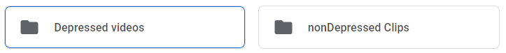
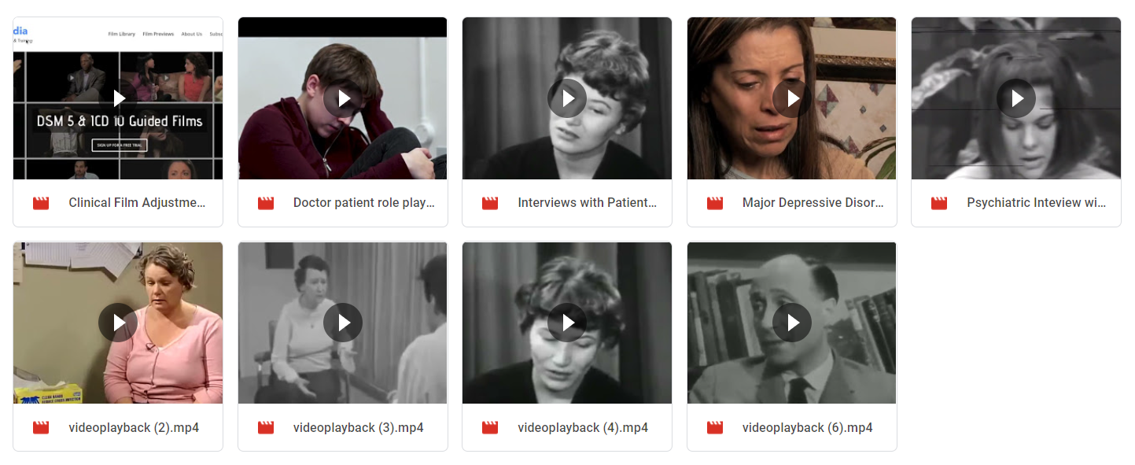
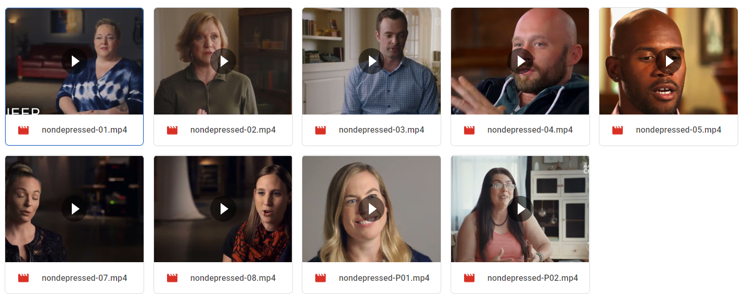
Data Collection Process
IT18120226 | Oshadi Yashodhika G. B. | 2021-073

Slide 18
Data Analysis – Data Labeling
Videos were separated into frames.
Each separated video frame was labelled with the help of external supervisor, Ms. Shalindi Pandithkoralage.
Video Frames were labelled as depressed images and non-depressed images.
Depressed Individuals – 15
Video Frames – 1,322
Non-depressed Individuals – 12
Video Frames – 1,747
IT18120226 | Oshadi Yashodhika G. B. | 2021-073

Slide 19
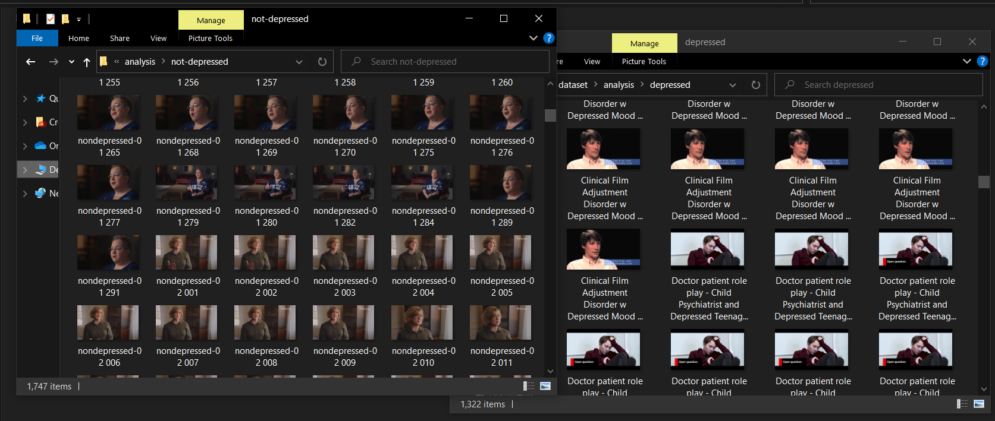
Data Labeling Process
IT18120226 | Oshadi Yashodhika G. B. | 2021-073

Slide 20
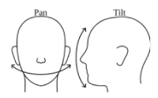
Data Analysis – Feature Extraction
Affectiva JavaScript API was used to extract facial features [1].
One of the leaders in emotion recognition technology.
Free Version
Pre-defined model, RealHePoNet was used for Head Pose Estimation [2].
Estimation of vertical(tilt/pitch) and horizontal (pan/yaw) angles.
Accuracy → 97% (Pointing’04 Dataset)
91% (Annotated Facial Landmarks in the Wild Dataset)
IT18120226 | Oshadi Yashodhika G. B. | 2021-073

Slide 21
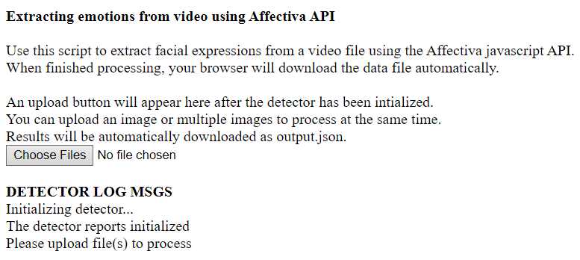
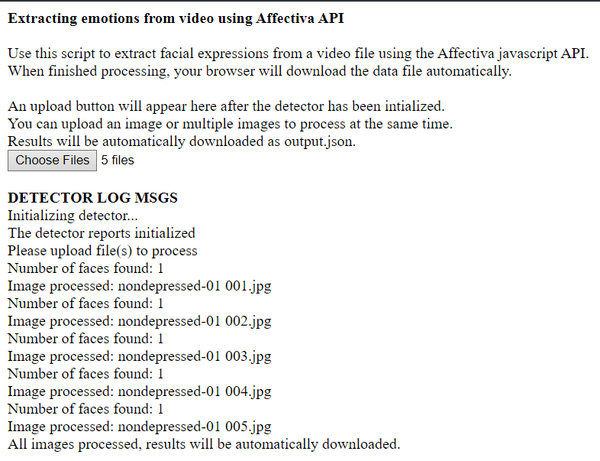
Process of Affectiva JavaScript API
1
2
IT18120226 | Oshadi Yashodhika G. B. | 2021-073

Slide 22
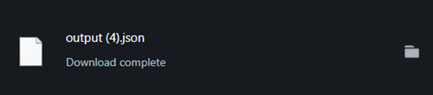
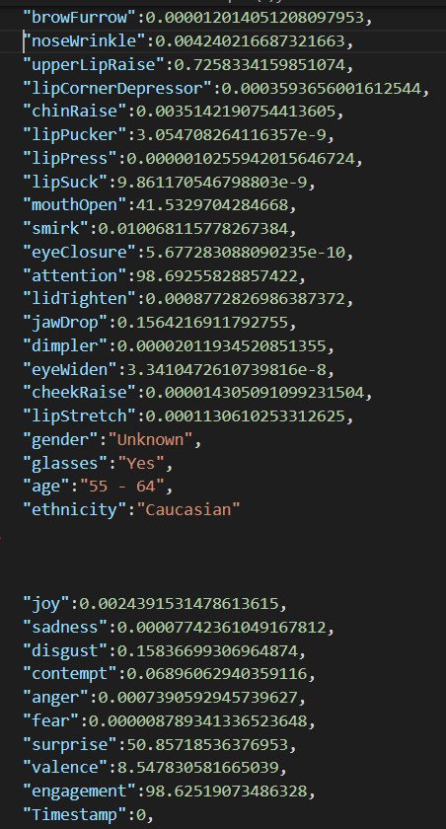
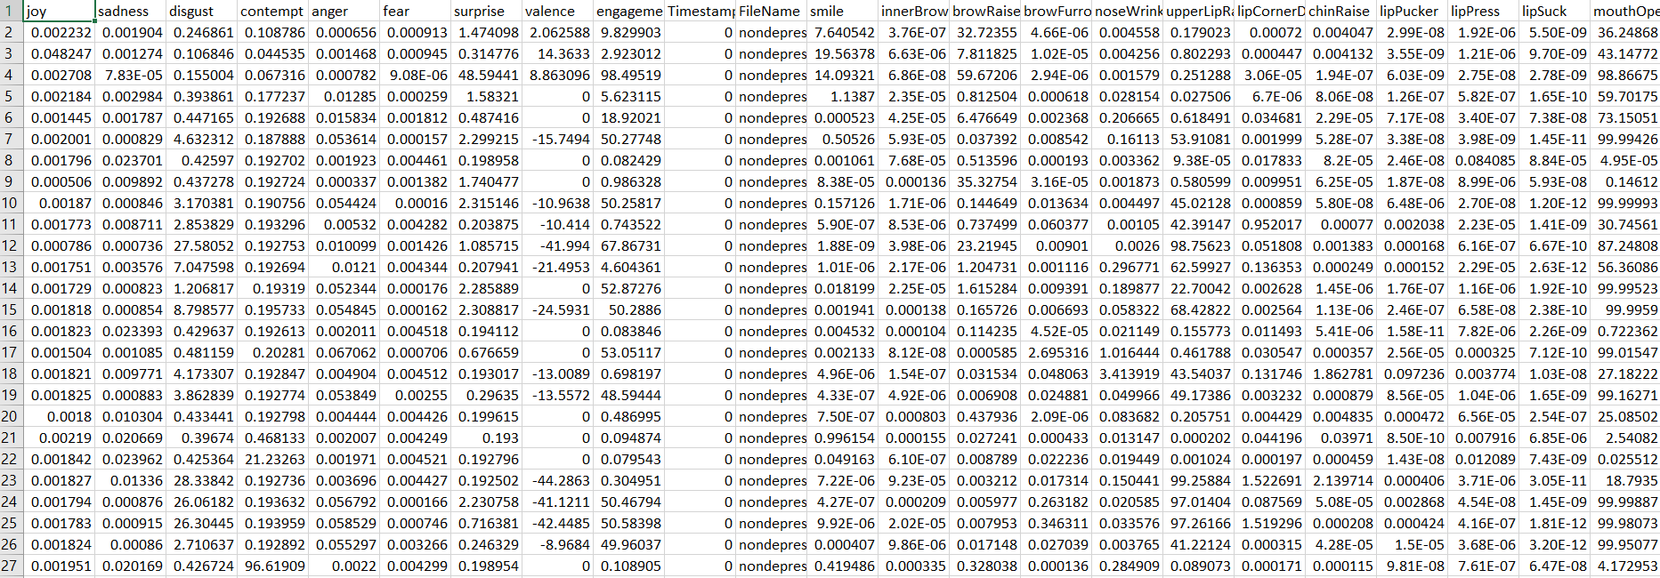
Process of Affectiva JavaScript API – Cont’d
Json Output (CSV File)
IT18120226 | Oshadi Yashodhika G. B. | 2021-073

Slide 23
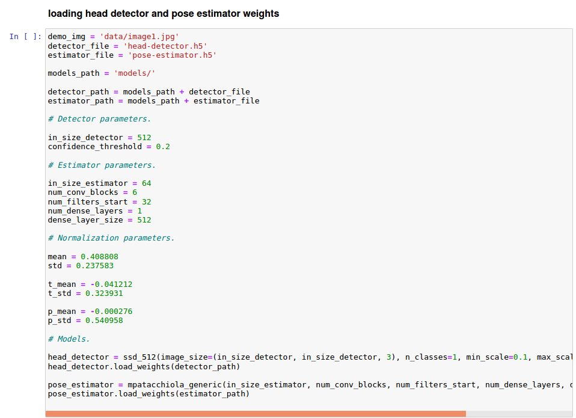
Process of RealHePoNet
1
IT18120226 | Oshadi Yashodhika G. B. | 2021-073

Slide 24
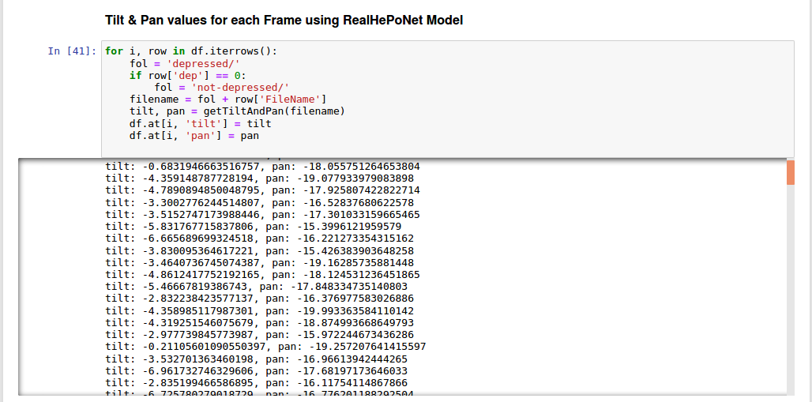
Process of RealHePoNet– Cont’d
2
IT18120226 | Oshadi Yashodhika G. B. | 2021-073

Slide 25
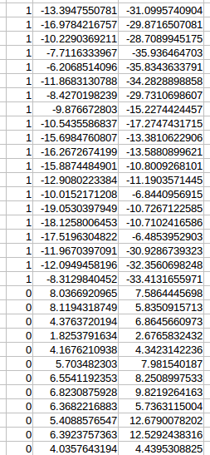
Process of RealHePoNet– Cont’d
Output (CSV File)
IT18120226 | Oshadi Yashodhika G. B. | 2021-073

Slide 26
Model Implementation & Testing
Emotion Based Depression Analysis Model
Accuracy (Test Accuracy) → 80%
Head Pose Based Depression Analysis Model
Accuracy (Test Accuracy) →77%
Ensemble Model to identify abnormal behaviors towards depression
Accuracy (Test Accuracy) →79%
IT18120226 | Oshadi Yashodhika G. B. | 2021-073

Slide 27
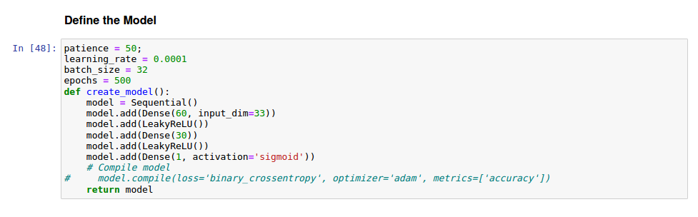
Emotion Based Depression Analysis Model
Emotion Based Depression Analysis Model is Built using Sequential Model.
IT18120226 | Oshadi Yashodhika G. B. | 2021-073

Slide 28
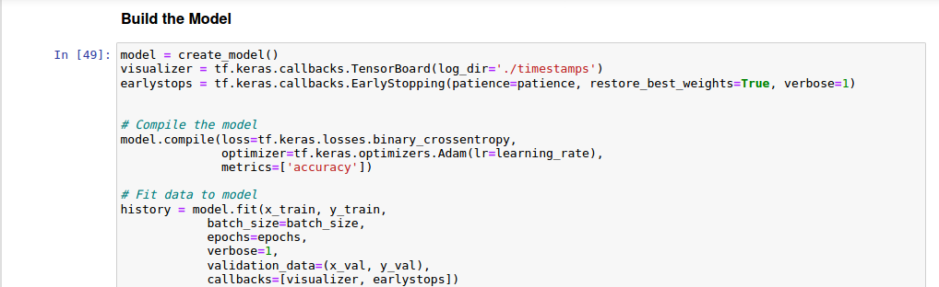
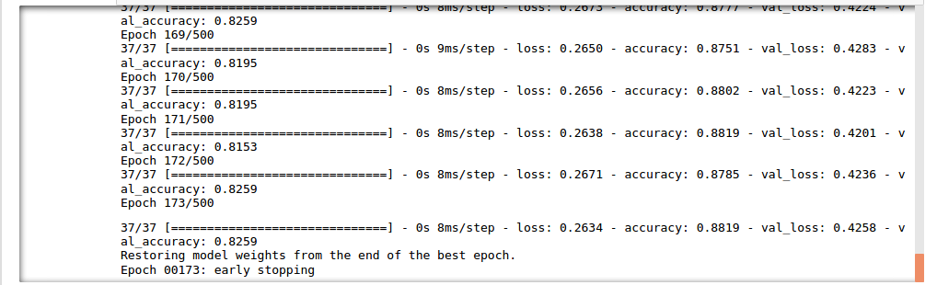
Emotion Based Depression Analysis Model – Cont’d
IT18120226 | Oshadi Yashodhika G. B. | 2021-073

Slide 29
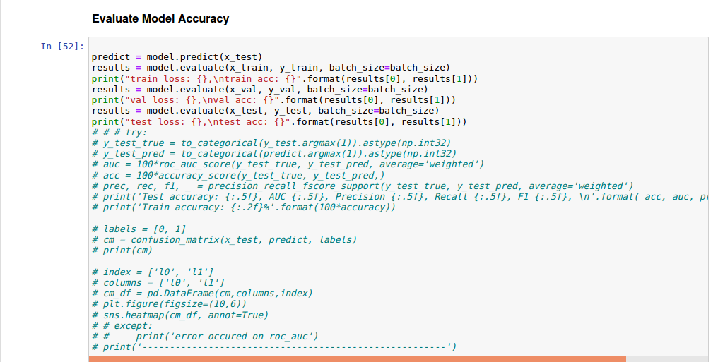
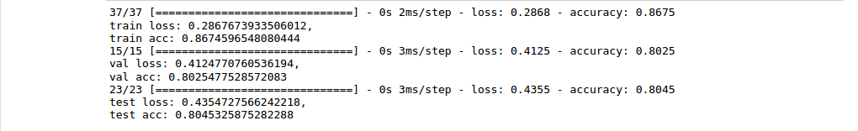
Emotion Based Depression Analysis Model – Cont’d
IT18120226 | Oshadi Yashodhika G. B. | 2021-073

Slide 30
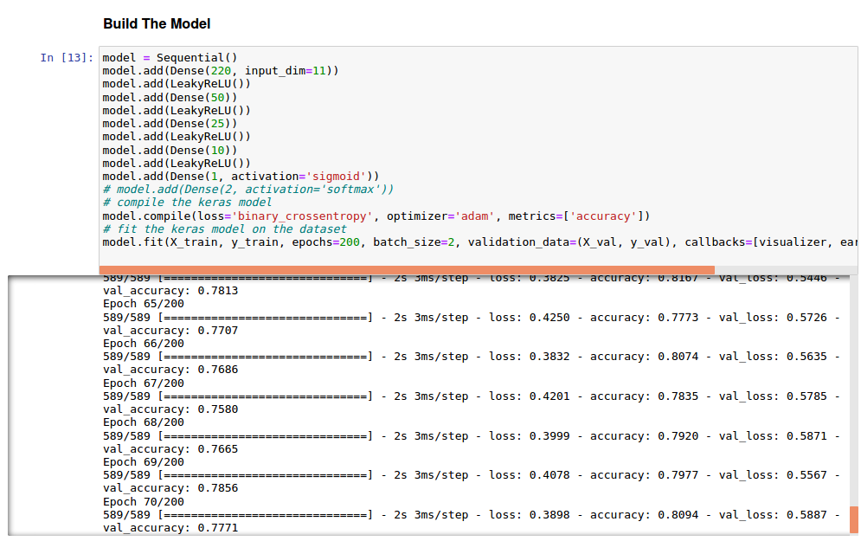
Head Pose Based Depression Analysis Model
Head Pose Based Depression Analysis Model is Built using Sequential Model.
IT18120226 | Oshadi Yashodhika G. B. | 2021-073

Slide 31
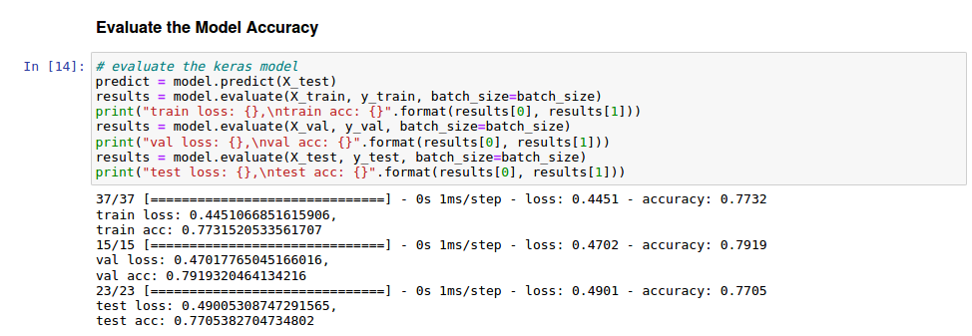
Head Pose Based Depression Analysis Model – Cont’d
IT18120226 | Oshadi Yashodhika G. B. | 2021-073

Slide 32
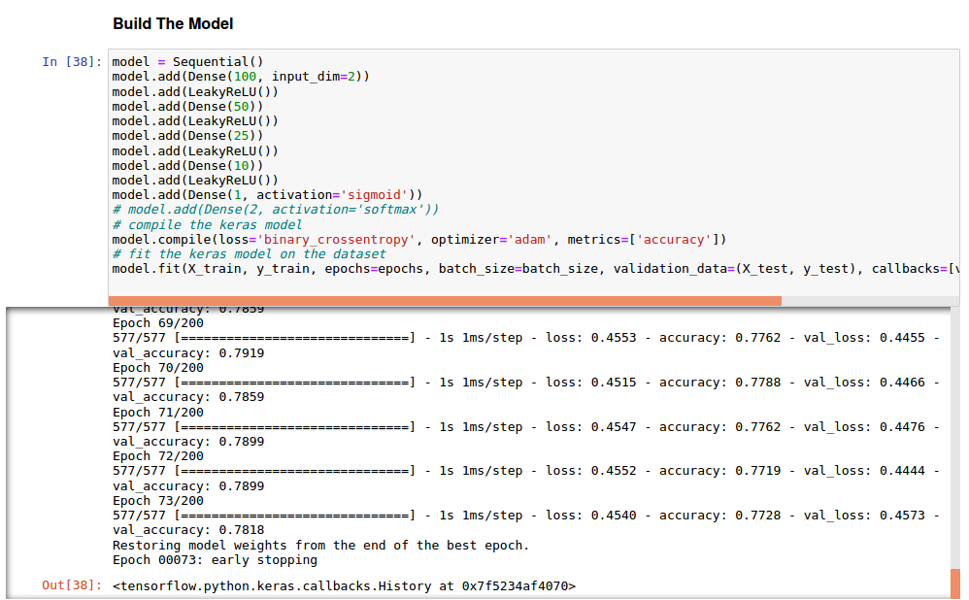
Ensemble Model
Ensemble Model is Built using Sequential Model.
IT18120226 | Oshadi Yashodhika G. B. | 2021-073

Slide 33
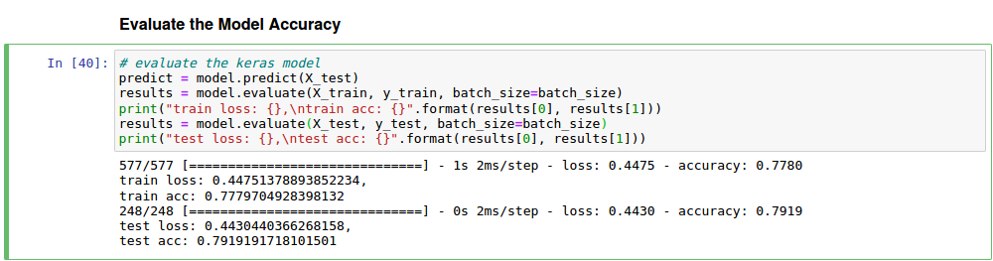
Ensemble Model – Cont’d
IT18120226 | Oshadi Yashodhika G. B. | 2021-073

Slide 34
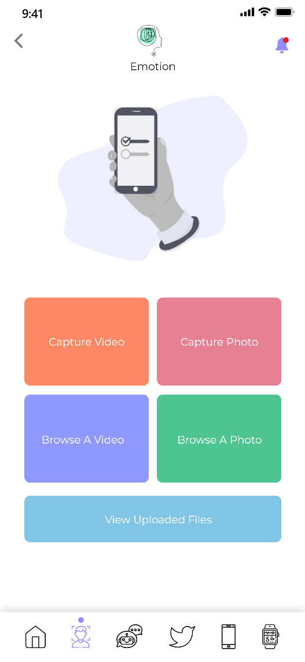
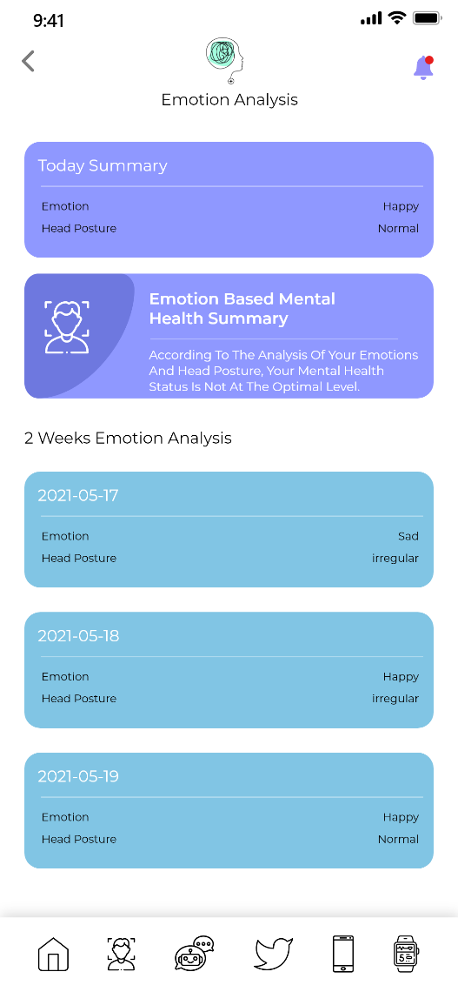
Mobile App Implementation - Wireframes
IT18120226 | Oshadi Yashodhika G. B. | 2021-073

Slide 35
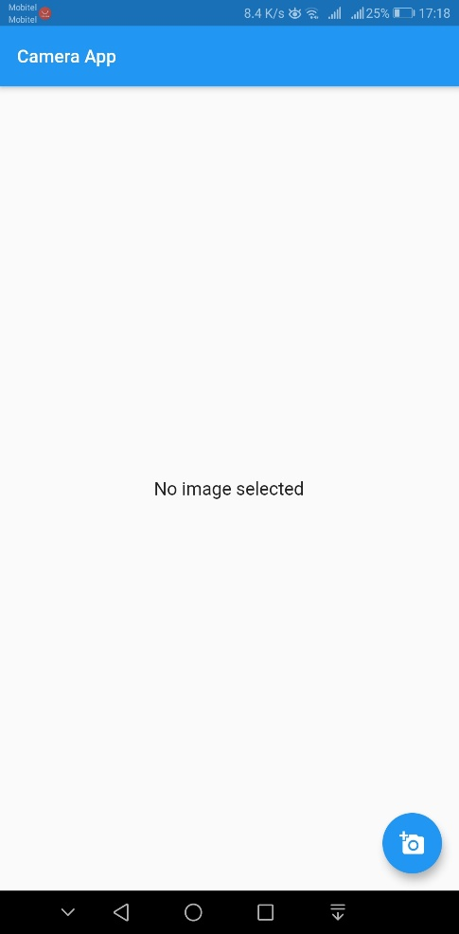
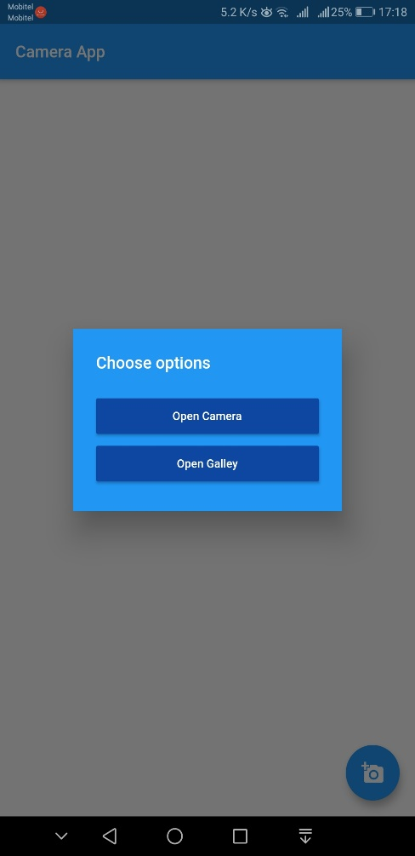
Mobile App Interfaces
1
2
IT18120226 | Oshadi Yashodhika G. B. | 2021-073

Slide 36

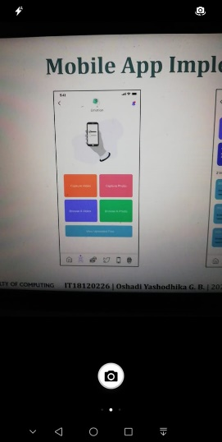
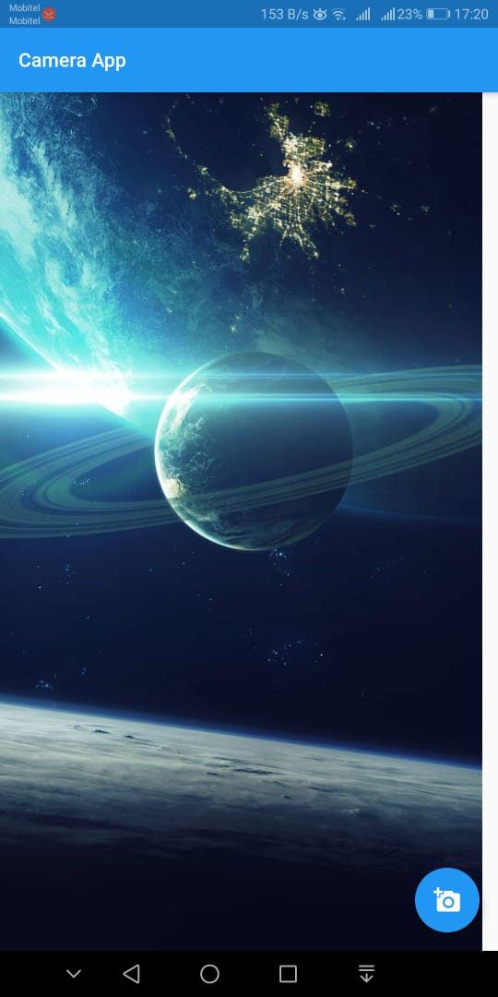
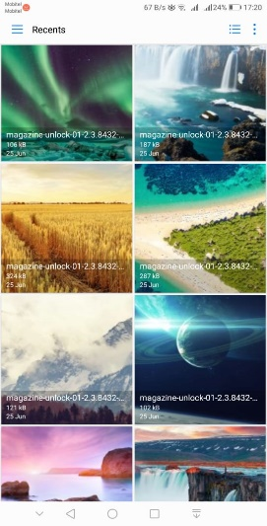
Mobile App Interfaces – Cont’d
3
4.1
5
4.2
IT18120226 | Oshadi Yashodhika G. B. | 2021-073

Slide 37

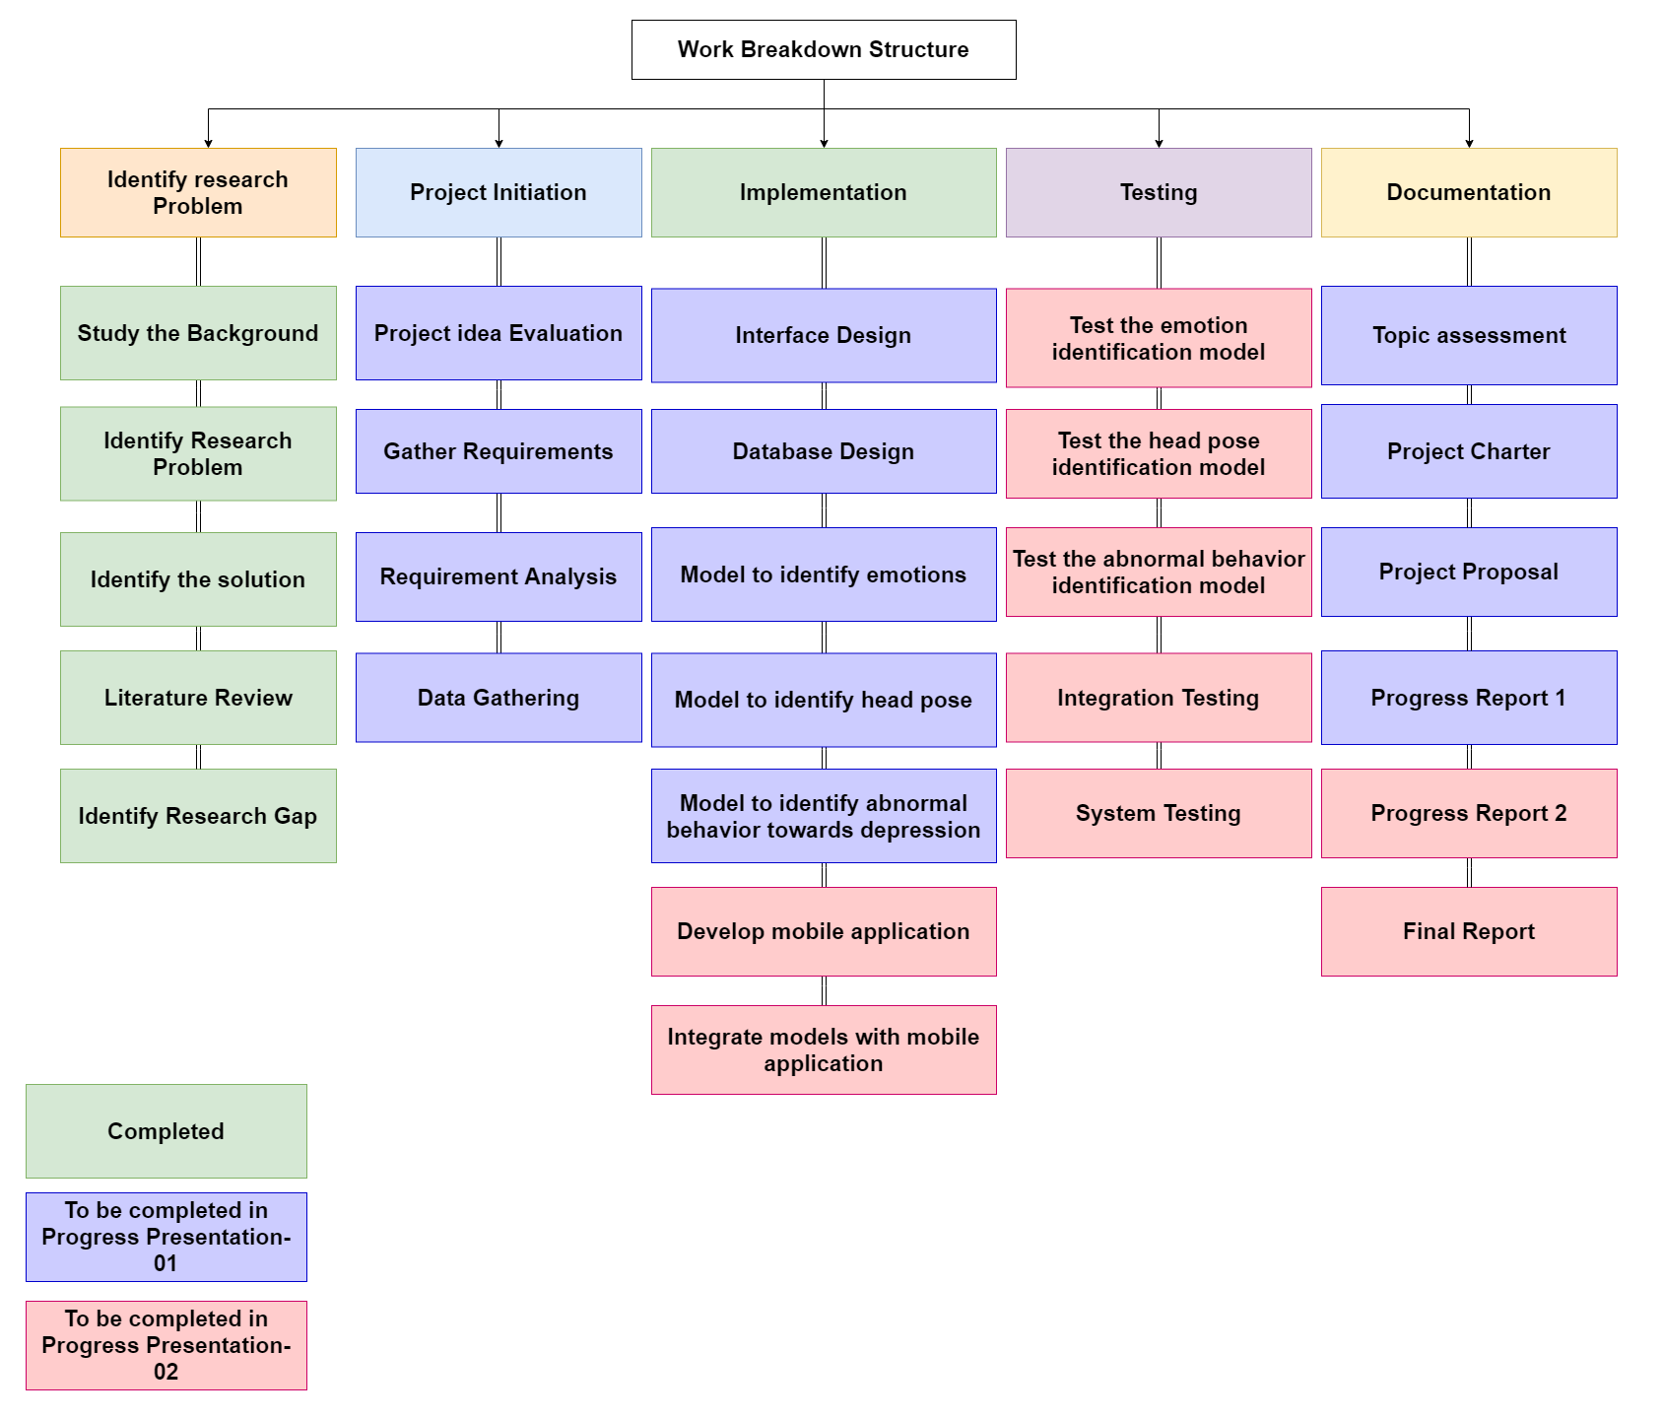
Work Breakdown Structure
IT18120226 | Oshadi Yashodhika G. B. | 2021-073

Slide 38
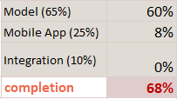
Individual Progress
→ Data Collection & Analysis.
Progress To Be
→ Mobile App Implementation.
→ Integration.
→ Model Implementation.
Current Progress
IT18120226 | Oshadi Yashodhika G. B. | 2021-073

Slide 39
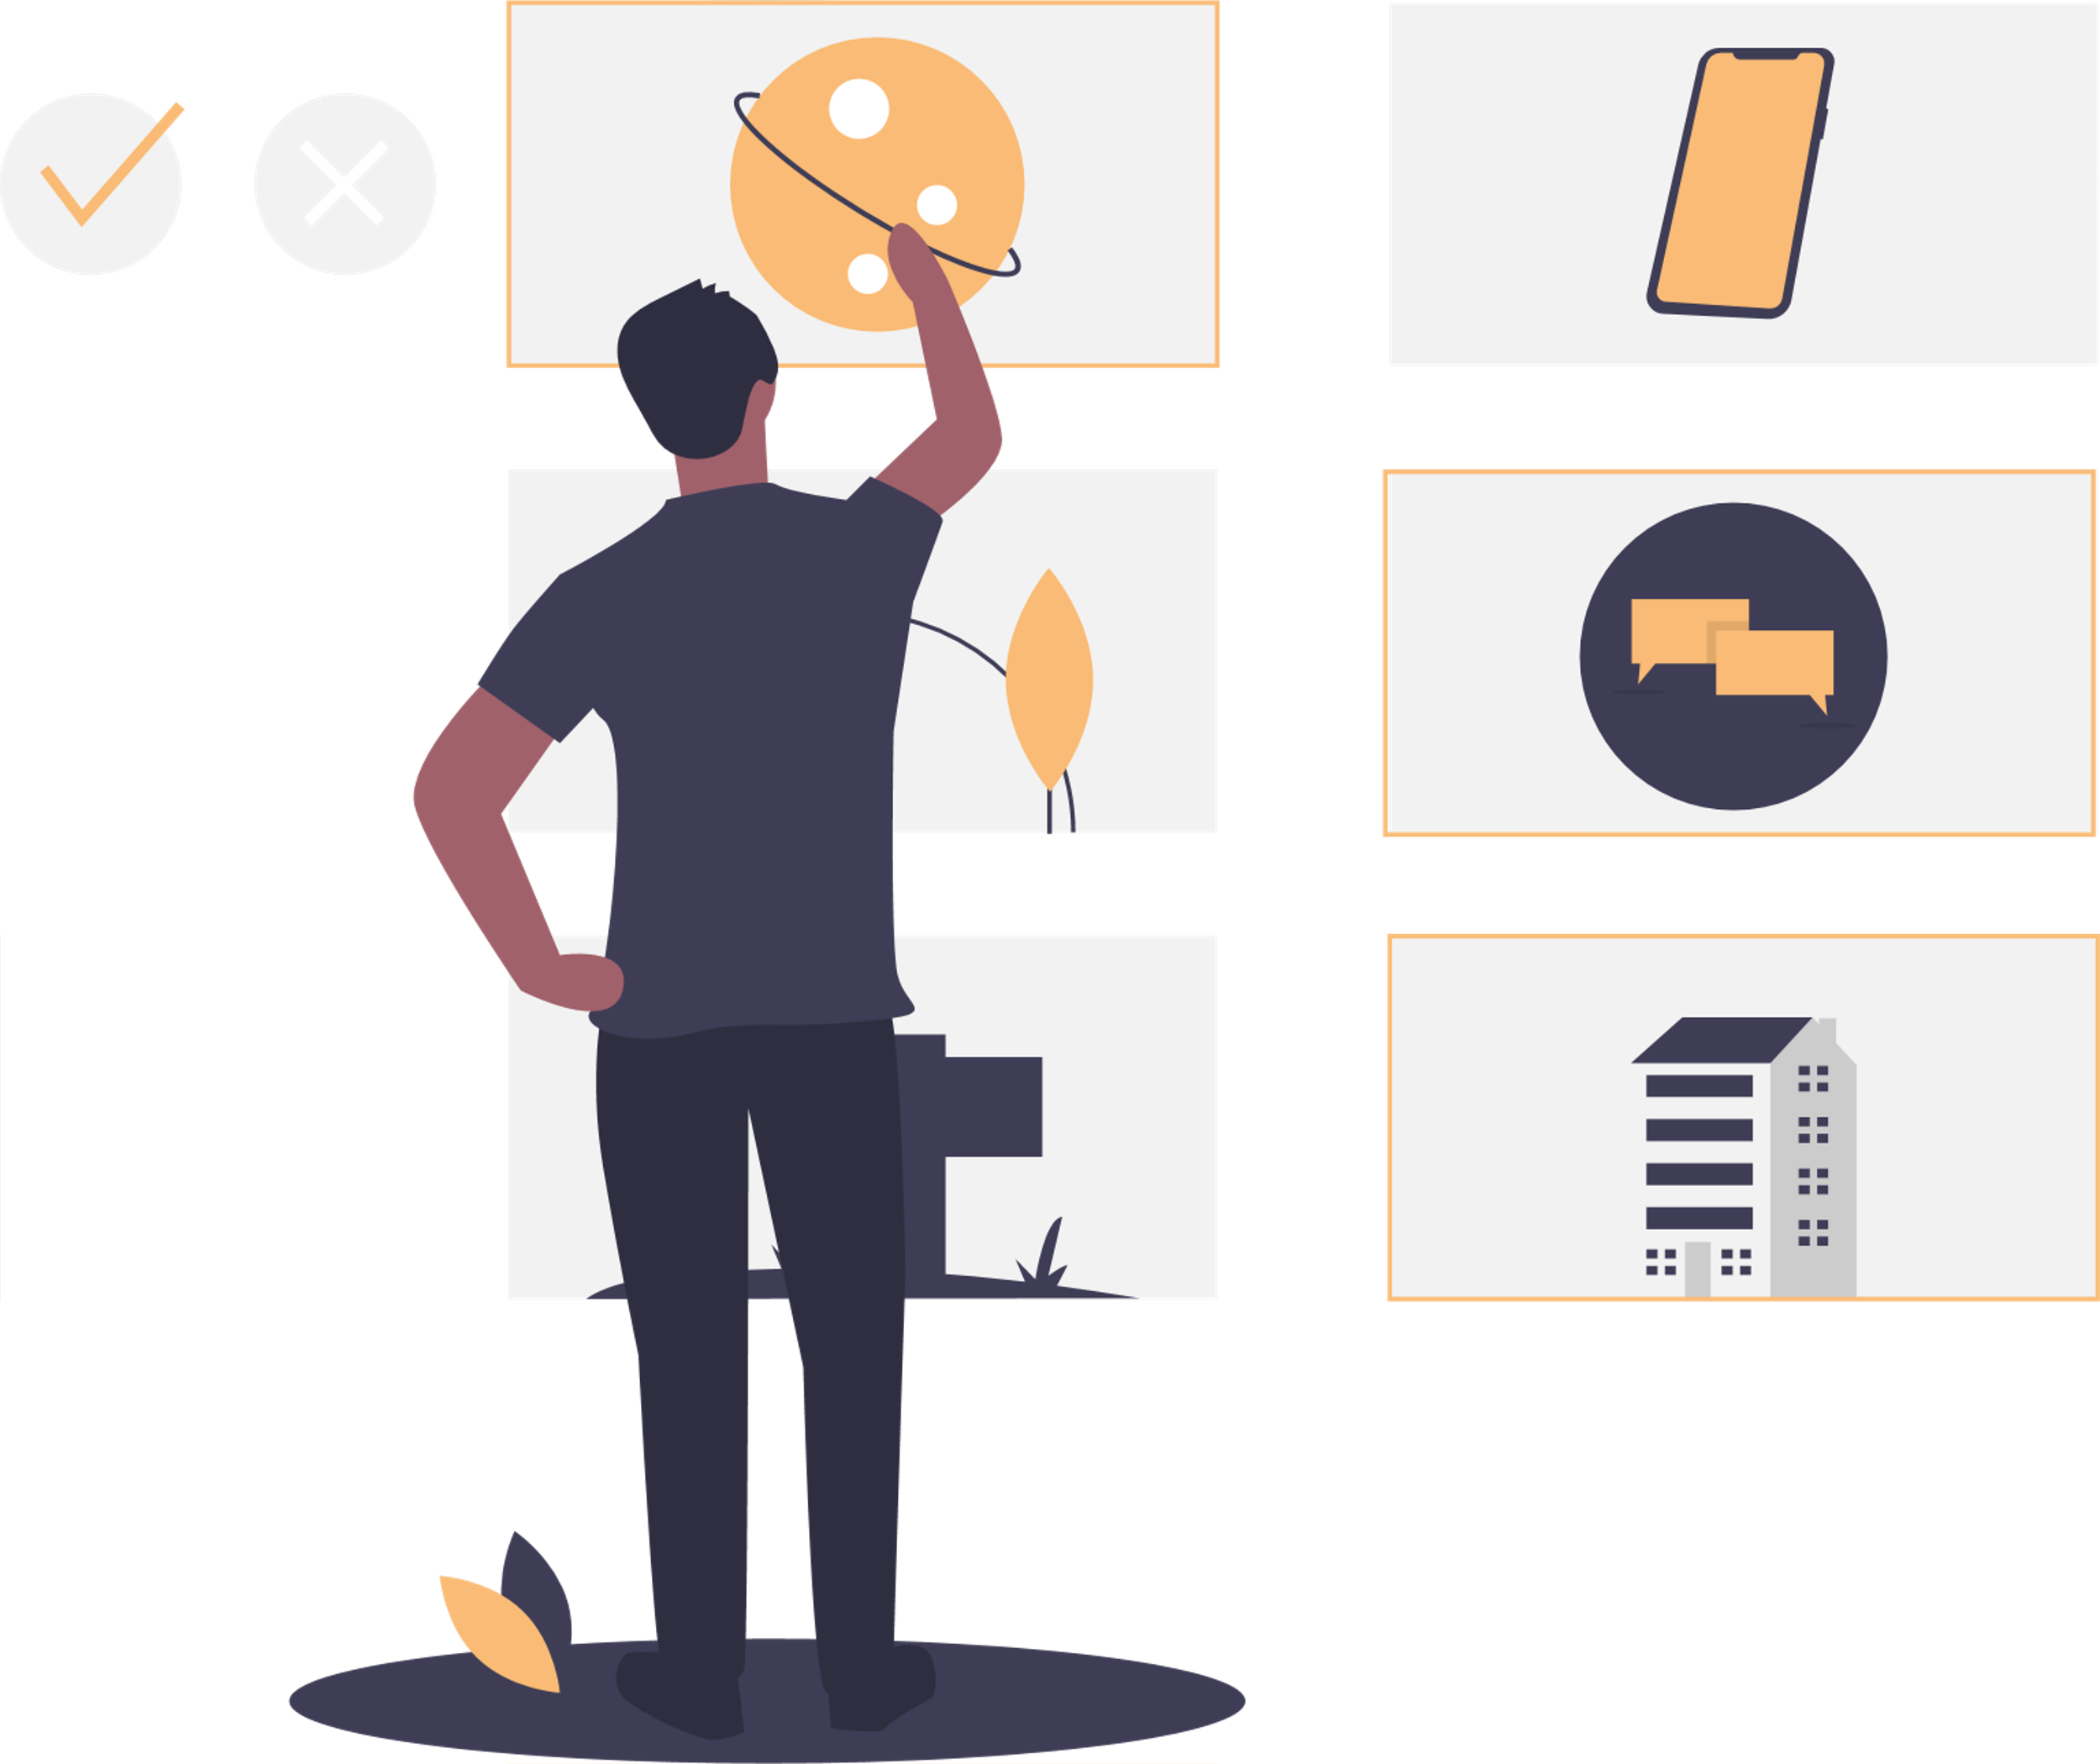
References
[1] L. Kulke, D. Feyerabend, and A. Schacht, “A comparison of the affectiva iMotions facial expression analysis software with EMG for identifying facial expressions of emotion,” Front. Psychol., vol. 11, p. 329, 2020.
[2] R. Berral-Soler, F. J. Madrid-Cuevas, R. Muñoz-Salinas, and M. J. Marín-Jiménez, “RealHePoNet: a robust single-stage ConvNet for head pose estimation in the wild,” Neural Comput. Appl., vol. 33, no. 13, pp. 7673–7689, 2021.
.
IT18120226 | Oshadi Yashodhika G. B. | 2021-073

Slide 40
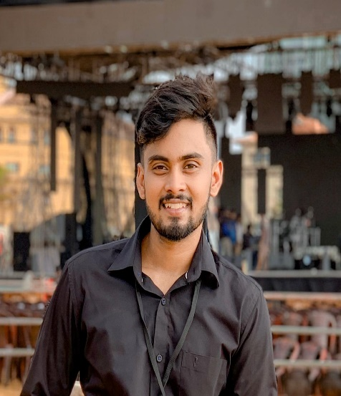
IT18113914 |De silva l. s. r
Information Technology
IT18113914 | De Silva L. S. R. | 2021-073

Slide 41

SOCIAL MEDIA CONTENT ANALYSIS FOR EARLY IDENTIFICATION OF DEPRESSIVE DISORDER
Research Question
Specific and Sub Objectives
Evidences for the Completion
IT18113914 | De Silva L. S. R. | 2021-073

Slide 42
Research Question
Difficult to monitor individuals manually for two weeks.
Lack the automated solution to identify early depression symptoms using Social media platform.
Lack the automated solution to analyze conversations to identify early depression symptoms.
Social stigma hinders individuals for attending counseling sessions.
IT18113914 | De Silva L. S. R. | 2021-073

Slide 43
Specific and Sub Objectives
Specific Objective
Social media content analysis for early identification of depressive disorder
Sub Objectives
Build a database based on Social Media Content.
Identify social media texting patterns based on the built database.
Build a classifier to model, abnormal social activities based on social media content.
Predict the probability of abnormal social activities towards depression with the designed model.
Design and implement ChatBot to initiate conversations, identify depressive thoughts based on conversations.
IT18113914 | De Silva L. S. R. | 2021-073

Slide 44
Implementation Progress
Data Collection
Data Analysis
Model Implementation and Testing
Mobile App
Implementation
Model Integration with Mobile App
Complete Mobile App
Social Media Content Dataset
Chatbot Conversation Dataset
Translation
Word Embedding
English Model
Sinhala Model
ChatBot Model
Interface
Design
Functionality Implementation
Interface Implementation
Completed
API Implementation
Pipeline Implementation
To be Completed (PP2)
To be Completed (Final)
Model & Application Deployment
IT18113914 | De Silva L. S. R. | 2021-073

Slide 45
Data Collection
Russian Dataset of Depressive Posts collected from Social Media [3].
Public Accounts of Vkontakte Social Network.
Commonwealth of Independent States (CIS) Countries.
Dataset for ChatBot was obtained from DAIC-WOZ database [4].
Wizard-of-Oz interviews, conducted by an animated virtual interviewer (Ellie)
Controlled by a human interviewer in another room.
Designed to support the diagnosis of psychological distress conditions.
Interview Sessions – 189 Sessions
IT18113914 | De Silva L. S. R. | 2021-073

Slide 46
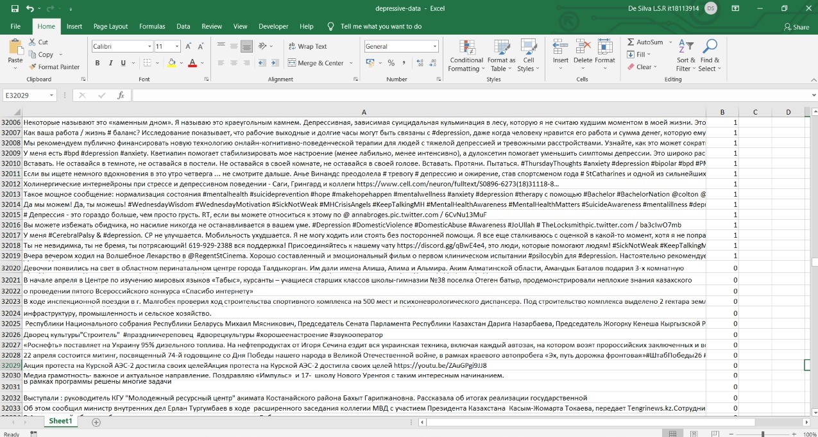
Data Collection – Russian Dataset
The collected data was
classified by psychologists.
The dataset consists of
32 018 depressive posts
and 32 021 non-depressive
posts.
IT18113914 | De Silva L. S. R. | 2021-073

Slide 47
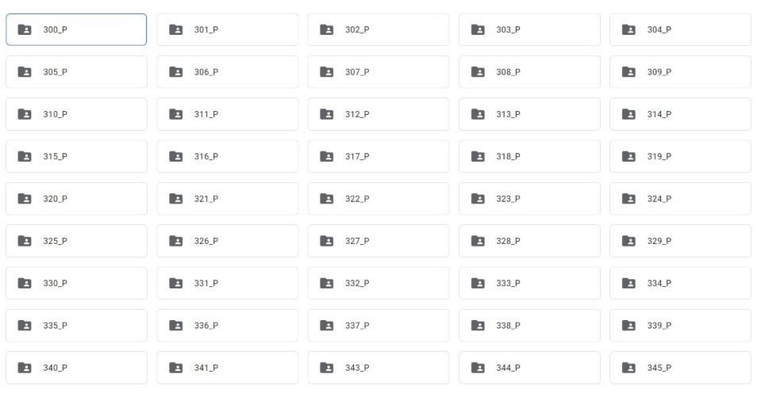
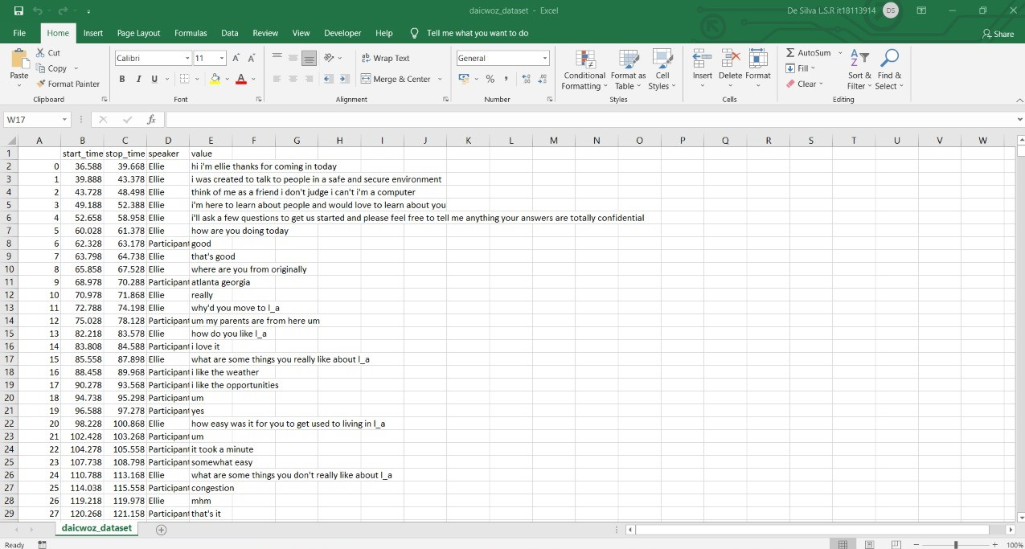
Data Collection – ChatBot Conversation Dataset
189 ChatBot Conversation
CSV Files.
7-33min (with an average of 16min).
IT18113914 | De Silva L. S. R. | 2021-073

Slide 48
Data Analysis – Translation
Translate Russian Language to English Language
Pre-defined model, MarianMT Transformers was used to translate dataset into English Language [5].
Translate Russian Language to Sinhala Language
Google Translator used to translate dataset into Sinhala Language.
IT18113914 | De Silva L. S. R. | 2021-073

Slide 49
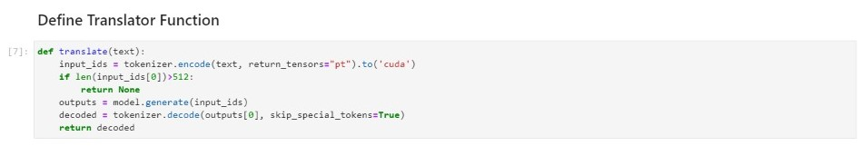
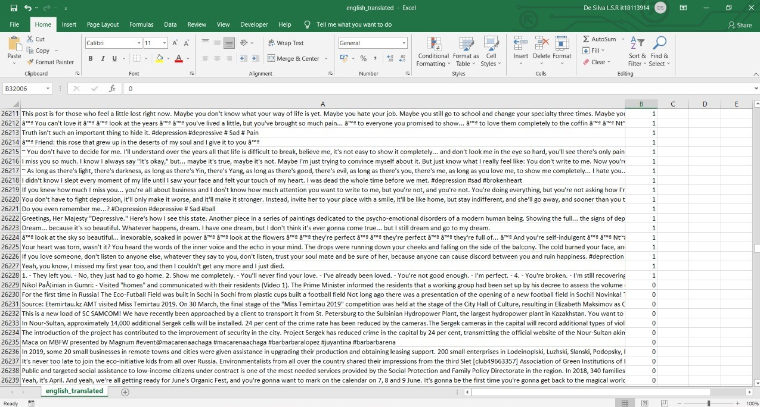
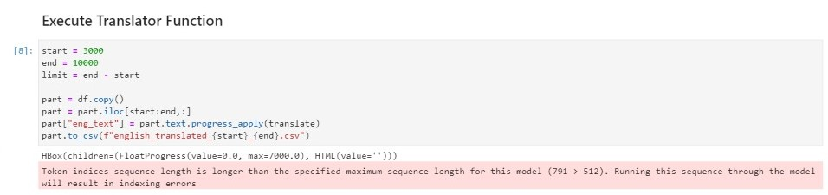
Data Analysis – English Translation
Russian Dataset (CSV File)
IT18113914 | De Silva L. S. R. | 2021-073

Slide 50
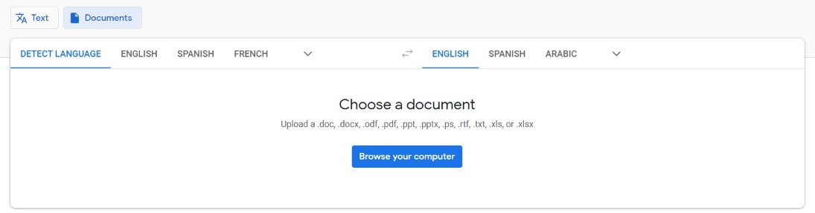
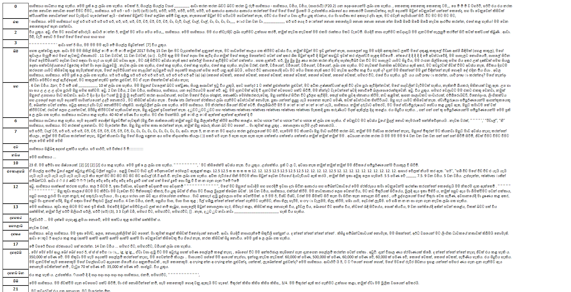
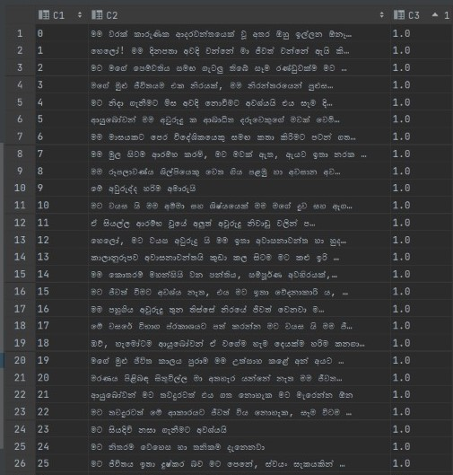
Data Analysis – Sinhala Translation
1
2
Translation Output (CSV File)
3
Google Translator
Translation Output (HTML File)
IT18113914 | De Silva L. S. R. | 2021-073

Slide 51
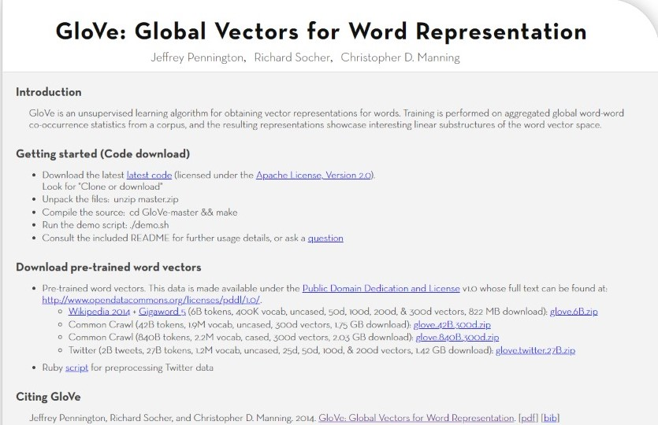
Data Analysis – Word Embedding
Word Embedding for English Content [6].
GloVe Vector Model was developed by Stanford University.
It supports for FastText Model (Library for word Embeddings and Text Classification).
IT18113914 | De Silva L. S. R. | 2021-073

Slide 52

Word Embedding – Cont’d
Word Embedding for Sinhala Content [7].
Sinhalese Vector Model was developed by Facebook's AI Research lab.
IT18113914 | De Silva L. S. R. | 2021-073

Slide 53
Model Implementation & Testing
English Content Based Depression Analysis Model
Accuracy (Test Accuracy) → 96%
Sinhala Content Based Depression Analysis Model
Accuracy (Test Accuracy) → 95%
ChatBot Implementation to identify depressive thoughts
Accuracy (Test Accuracy) → 96%
IT18113914 | De Silva L. S. R. | 2021-073

Slide 54

English Content Based Depression Analysis Model
English Content Based Depression Analysis Model is Build using FastText model.
IT18113914 | De Silva L. S. R. | 2021-073

Slide 55

English Content Based Depression Analysis Model – Cont’d
IT18113914 | De Silva L. S. R. | 2021-073

Slide 56

Sinhala Content Based Depression Analysis Model
Sinhala Content Based Depression Analysis Model is Build using FastText Model.
IT18113914 | De Silva L. S. R. | 2021-073

Slide 57

Sinhala Content Based Depression Analysis Model – Cont’d
IT18113914 | De Silva L. S. R. | 2021-073

Slide 58
ChatBot Implementation
Rasa Framework is used in ChatBot Implementation.
Rasa is an Open Source Conversational AI to build contextual AI Assistant and Chatbots.
IT18113914 | De Silva L. S. R. | 2021-073

Slide 59

ChatBot – Cont’d
Intent – Define Possible User Inputs
Action – Response
Entity – Extract Information
Stories – Define the Flow
IT18113914 | De Silva L. S. R. | 2021-073

Slide 60



ChatBot– Cont’d
1
2
3
Stories
Actions
Intent
IT18113914 | De Silva L. S. R. | 2021-073

Slide 61

ChatBot– Cont’d
ChatBot Output
IT18113914 | De Silva L. S. R. | 2021-073

Slide 62

ChatBot– Cont’d
ChatBot Accuracy
Confusion Matrix
IT18113914 | De Silva L. S. R. | 2021-073

Slide 63



Mobile App Implementation - Interfaces
IT18113914 | De Silva L. S. R. | 2021-073

Slide 64


Mobile App Interfaces – Cont’d
IT18113914 | De Silva L. S. R. | 2021-073

Slide 65

Mobile App Implementation – Cont’d
Access to the Twitter developer account.
IT18113914 | De Silva L. S. R. | 2021-073

Slide 66


Mobile App Implementation – Cont’d
1
2
ChatBot Interface Design.
IT18113914 | De Silva L. S. R. | 2021-073

Slide 67

Work Breakdown Structure
IT18113914 | De Silva L. S. R. | 2021-073

Slide 68

Individual Progress
→ Data Collection & Analysis.
Progress To Be
→ Mobile App Implementation.
→ Integration.
→ Model Implementation.
Current Progress
IT18113914 | De Silva L. S. R. | 2021-073

Slide 69

References
[3] S. Narynov, D. Mukhtarkhanuly, and B. Omarov, “Dataset of depressive posts in Russian language collected from social media,” Data Brief, vol. 29, no. 105195, p. 105195, 2020.
[4] J. Gratch et al., “The Distress Analysis Interview Corpus of human and computer interviews,” in Proceedings of the Ninth International Conference on Language Resources and Evaluation (LREC’14), 2014, pp. 3123–3128.
[5] “MarianMT,” Huggingface.co. [Online]. Available: https://huggingface.co/transformers/model_doc/marian.html. [Accessed: 05-Jul-2021].
[6] J. Pennington, R. Socher, and C. Manning, “Glove: Global vectors for word representation,” in Proceedings of the 2014 Conference on Empirical Methods in Natural Language Processing (EMNLP), 2014.
[7] “Word vectors for 157 languages,” Fasttext.cc. [Online]. Available: https://fasttext.cc/docs/en/crawl-vectors.html. [Accessed: 05-Jul-2021].
IT18113914 | De Silva L. S. R. | 2021-073

Slide 70

IT18119718 |Liyanage D.r.y
Information Technology
IT18119718 | Liyange D. R. Y. | 2021-073

Slide 71

PHONE USAGE PATTERN ANALYSIS TO EARLY IDENTIFICATION OF DEPRESSIVE DISORDER
Research Question
Specific and Sub Objectives
Evidences for the Completion
IT18119718 | Liyange D. R. Y. | 2021-073

Slide 72
Research Question
Lack of the automated applications that focus on identify early depression disorder using Phone usage data.
Two-week manual monitoring of individual difficulty.
Lack of systems that acquire data without the user’s contribution.
Individuals tend to avoid medications due to the negative impact on society.
IT18119718 | Liyange D. R. Y. | 2021-073

Slide 73
Specific and Sub Objectives
Specific Objective
Identify the individuals that in the lead to depression disorder based
on their phone usage pattern changes.
Sub Objectives
Recognize the key factors of phone usage to identify depressive disorder changes.
Build a service to run in the mobile in order to log the key factor’s data.
Based on data build a classifier to model, abnormal phone use based on mobile phone usage
Predict the probability of abnormal phone use towards depression with the designed model.
Integrate the classifier to the mobile app
IT18119718 | Liyange D. R. Y. | 2021-073
IT18119718 | Liyange D. R. Y. | 2021-073

Slide 74
Implementation Progress
Data Collecting
Data Analyzing
Model Implementation & Deploy
Access Phone Usage
Implement API to Identify App Category
Separate and store App Details
App detail calculation and rendering
Data Labeling
Data preprocessing
Model accuracy Testing
API Implementation
API Testing
Deploy in server
Access Method
Clean accessed Data
API Implementation
Test API
Deploy API in server
Completed
Integrate Category API with APP
App detail
Arranging
Store in firebase
To be Completed (PP2)
To be Completed (Final)
IT18119718 | Liyange D. R. Y. | 2021-073

Slide 75
Implementation Progress
Model Integration with app
Individual components integration
Mobile App Integration
API end point access
Output the prediction
UI Implementation
Complete the Individual Component
Testing
Complete UI
Functionality Testing
Final Testing
Completed
To be Completed (PP2)
To be Completed (Final)
IT18119718 | Liyange D. R. Y. | 2021-073

Slide 76

Data Collection
Data Collected through questionnaire according to phycological standard
Individuals: 350
Individual’s Age Range : 16 – 30
IT18120226 | Oshadi Yashodhika G. B. | 2021-073

Slide 77
Data Analysis
Data Labeling
The data Have been Labeled according to the world standards.
Standard: PHQ-9 Scores and Proposed Treatment Actions
Guidance: Clinical Psychologist (External supervisor )
Data Preprocessing
Clean data: Remove Rows with Missing Values, Encoding
Categorizing: Identify the Depression levels according to PHQ-9 Scores
Depressed Individuals – 100 (Mild: 62 / Moderate:27 / severe: 11)
IT18119718 | Liyange D. R. Y. | 2021-073

Slide 78


Data Analysis (Cont’d)
Data Labeling
IT18119718 | Liyange D. R. Y. | 2021-073

Slide 79






Data Analysis (Cont’d)
Data Preprocessing
IT18119718 | Liyange D. R. Y. | 2021-073

Slide 80
Model Implementation and Deploy
Model Implementation
Model have been Implemented with supervised learning classification Algorithms.
k-nearest neighbors (KNN) algorithm : Accuracy at k = 15 → 0.7571428571428571
Support Vector Machine (SVM) algorithm : Accuracy for kernel = poly with degree = 3 → 0.671428571
Random Forest algorithm: Accuracy → 0.5857142857142857
From The Best Accuracy model KNN Pickle file have been separated for API purposes.
IT18119718 | Liyange D. R. Y. | 2021-073

Slide 81




Model Implementation and Deploy (Cont’d)
Model Implementation (KNN)
Train Test Set Splitting
Maximum Accuracy K
Model Accuracy
Dump Pickle
Minimum Error K finding
IT18119718 | Liyange D. R. Y. | 2021-073

Slide 82


Model Implementation and Deploy (Cont’d)
Model Implementation (SVM)
Model Implementation (Random Forest)
IT18119718 | Liyange D. R. Y. | 2021-073

Slide 83
Model Implementation and Deploy (Cont’d)
Model API Implementation.
Using the Model Pickle file write an API for access the model in Mobile Application.
Methods used: Python Fast API
Purpose : In order to Pass phone usage parameters and acquire the Prediction.
API Deploy In server
The implemented API has been deployed in the server for secure accessibility .
Server: Deployed in Heroku
API Testing.
Used Swagger to test the API .
IT18119718 | Liyange D. R. Y. | 2021-073

Slide 84



Model Implementation and Deploy (Cont’d)
API Implementation
Import Pickle File
IT18119718 | Liyange D. R. Y. | 2021-073

Slide 85




Model Implementation and Deploy (Cont’d)
API Deploy (Heroku)
API Testing (Swagger)
IT18119718 | Liyange D. R. Y. | 2021-073

Slide 86
Access Phone Usage
Accessing The Phone Usage
In order to Access the App Usage Data Of the user have used the Flutter Package.
Package → app_usage:1.2.0
Minimum SDK for the Package → 21
Language: Flutter and Dart
Clean accessed Data.
The Data retrieving from the package is not readable, So we need to Go with some steps to make them Readable.
IT18119718 | Liyange D. R. Y. | 2021-073

Slide 87


Access Phone Usage (Cont’d)
Accessing The Phone Usage
Package
Minimum SDK Version
IT18119718 | Liyange D. R. Y. | 2021-073

Slide 88


Access Phone Usage (Cont’d)
Clean Data
Before Clean
After Clean
IT18119718 | Liyange D. R. Y. | 2021-073

Slide 89
API Implementation To identify App Category
API Implementation
To Identify the categories of the mobile apps, required to implement a Method .
Issue : There was No recourses to apply in order to identify the app category.
Solution : Implemented an API to identify app category.
Method: according to the package name of the mobile app Access google Play store Browser HTML selector and get the category for this process implemented an API.
Framework use to implement : Laravel
Library: crawler
IDE: PhpStorm
Deploy And Test API.
The API is Deployed for Accessing through flutter app and Tested for ensure the process.
Deployed : Heroku
Test: Postman.
IT18119718 | Liyange D. R. Y. | 2021-073

Slide 90

API Implementation To identify App Category (Cont’d)
Copy The selector Path for use in the API Implantation
IT18119718 | Liyange D. R. Y. | 2021-073

Slide 91

API Implementation To identify App Category (Cont’d)
Pass the Package name of the APP To the URL
Selector Path Copied from Google Play Store Browser
IT18119718 | Liyange D. R. Y. | 2021-073

Slide 92



API Implementation To identify App Category (Cont’d)
API Deploy (Heroku)
API Testing (Postman)
Get The Category As Json Response
Pass Package Name with URL
IT18119718 | Liyange D. R. Y. | 2021-073

Slide 93
Separate and Store App Details.
Integrate the Category API to APP
The API is Integrated to flutter app to get the category type according to the apps used by the user.
Arrange The Used Apps.
The used apps will be organized necessarily.
Arrange in to Social and gamming app and system apps and other apps will be ignored .
Calculate the Total used gaming and Social Apps.
Store data
The daily calculated and organized data will be store in Firebase.
IT18119718 | Liyange D. R. Y. | 2021-073

Slide 94

Separate and Store App Details (Cont’d).
Integrate and Arrange The Used Apps
Integrate The API
IT18119718 | Liyange D. R. Y. | 2021-073

Slide 95

Separate and Store App Details (Cont’d).
Arrange The Used Apps
Apps Total duration
Arrange in to Social and gamming app and system apps and other apps will be ignored
IT18119718 | Liyange D. R. Y. | 2021-073

Slide 96


Separate and Store App Details (Cont’d).
Store data in Firebase
Stored data in Firebase
Firebase Packages and Files
IT18119718 | Liyange D. R. Y. | 2021-073

Slide 97
App Data Calculation and Rendering
Calculation and Renderings
calculate of 1 day, 1 week and 2 weeks data.
The organized and calculated data will be render to the screen
IT18119718 | Liyange D. R. Y. | 2021-073

Slide 98


App Data Calculation and Rendering (Cont’d).
Code segments to use arrange and render Out puts
IT18119718 | Liyange D. R. Y. | 2021-073

Slide 99


App Data Calculation and Rendering (Cont’d).
The Final view giving to the User.
The state of completed
Prediction from the model
IT18119718 | Liyange D. R. Y. | 2021-073

Slide 100

Work Breakdown Structure
IT18119718 | Liyange D. R. Y. | 2021-073

Slide 101

Individual Progress
→ Data Collection & Analysis.
Progress To Be
→ Model API Integration with APP.
→ Individual Component Integration.
→ Mobile App Integration
→ Model Implementation.
→ Mobile App Implementation.
Current Progress
IT18119718 | Liyange D. R. Y. | 2021-073

Slide 102

IT18119572 |ChathurAnga W.W.P.K
Information Technology
IT18119572 | Chathuranga W. W. P. K. | 2021-073

Slide 103

INVASIVE & NON – INVASIVE METHODS TO EARLY IDENTIFICATION OF DEPRESSIVE DISORDER
Research Question
Specific and Sub Objectives
Evidences for the Completion
IT18119572 | Chathuranga W. W. P. K. | 2021-073

Slide 104
Research Question
Lack of the automated applications that focus on identify early depression disorder using both invasive and non - invasive methods.
Lack of systems that acquire data without the user’s contribution.
Difficulties of two weeks manual monitoring individuals.
The social impact that makes individuals avoid medication and understand symptoms.
IT18119572 | Chathuranga W. W. P. K. | 2021-073

Slide 105
Specific and Sub Objectives
Specific Objective
Acquire invasive and non-invasive data analysis for early identification
of depressive disorder.
Sub Objectives
Recognize health parameters that can be collected using a wearable device to identify early depression symptoms.
Identify techniques as alternative methods to collect the same parameter data.
Collect data using invasive (wearable) and non-invasive techniques and build methods to identify early depression symptoms
Predict the probability of abnormal physical changes towards depression with the designed models.
Integrate both models into the mobile app.
IT18119572 | Chathuranga W. W. P. K. | 2021-073

Slide 106
Implementation Progress
Obtain Data
Data preprocessing
Model Implementation & Deploy
Invasively Data access using Wearable
Invasive Data Modifying and calculation
Rendering the Data
Invasive Model Integration with app
Model accuracy Testing
API End point
API Testing
Deploy in server
Google fit Authorization
Connect Google Fit to app
Access and Rendering data
Clean data
Store in firebase
Completed
API end point access
Output the prediction
To be Completed (PP2)
To be Completed (Final)
IT18119572 | Chathuranga W. W. P. K. | 2021-073

Slide 107
Implementation Progress
Non - Invasively Data access using mobile phone Sensors
Convert Accelerometer Data to sleep Data
Non- Invasive Data Modifying and calculation
Store and rendering the data
Non - Invasive Model Integration with app
Individual components integration
Mobile App Integration
Accelerometer Access
Phone camera and flasher access
Program Implementation
API Implementation
Testing
Deploy API in server
Clean data
Calculation
Store in firebase
API end point access
Testing
Output the prediction
Completed
Invasive & Non-Invasive integration
UI implementation
Complete Individual Component
Testing
To be Completed (PP2)
Complete UI
Functionality Testing
Final Testing
To be Completed (Final)
IT18119572 | Chathuranga W. W. P. K. | 2021-073

Slide 108
Obtain Data
The data have been collected Through Online Public database
Heart Rate data.
Parameters : Age, Gender, Heartrate
Total: 3798
Depressed Individuals: 483
Sleep Data
Parameters: Age, Gender, Total sleep, Ripped eye Moment Sleep (REM), Deep sleep, Light Sleep
Total: 530
Depressed Individuals: 71
IT18120226 | Oshadi Yashodhika G. B. | 2021-073
IT18119572 | Chathuranga W. W. P. K. | 2021-073

Slide 109


Data Pre-Processing
Data Preprocessing
Select Necessary Columns .
Added Necessary headings.
Remove Rows with Missing Values
Encoding
Data Categorizing
Select Necessary Columns
and
Give Headings
IT18119718 | Liyange D. R. Y. | 2021-073
IT18119572 | Chathuranga W. W. P. K. | 2021-073

Slide 110





Data Pre-Processing
Categorizing , Null Value Removing (Heart rate & Sleep data)
IT18119572 | Chathuranga W. W. P. K. | 2021-073
IT18119718 | Liyange D. R. Y. | 2021-073

Slide 111
Model Implementation and Deploy
Model Implementation
Models have been Implemented with supervised learning classification Algorithms.
Heart Rate Models
k-nearest neighbors (KNN) algorithm : Accuracy at k = 5 → 0.8447368421052631
Support Vector Machine (SVM) algorithm : Accuracy for kernel = rbf → 0.868421052631579
Sleep Models
k-nearest neighbors (KNN) algorithm : Accuracy at k = 5 → 0.9528301886792453
Support Vector Machine (SVM) algorithm : Accuracy for kernel = poly with degree = 2 → 0.9433962264150944
From The Best Accuracy models Pickle files have been separated for API purposes.
IT18119718 | Liyange D. R. Y. | 2021-073
IT18119572 | Chathuranga W. W. P. K. | 2021-073

Slide 112



Model Implementation and Deploy
Heart Rate Model Implementation (KNN)
Train Test Set Splitting
Maximum Accuracy K
Model Accuracy
Dump Pickle
Minimum Error K finding
IT18119572 | Chathuranga W. W. P. K. | 2021-073
IT18119718 | Liyange D. R. Y. | 2021-073

Slide 113

Model Implementation and Deploy (Cont’d)
Heart Rate Model Implementation (SVM)
IT18119572 | Chathuranga W. W. P. K. | 2021-073
IT18119718 | Liyange D. R. Y. | 2021-073

Slide 114


Model Implementation and Deploy
Sleep data Model Implementation (KNN)
Train Test Set Splitting
Maximum Accuracy K
Model Accuracy
Dump Pickle
Minimum Error K finding
IT18119572 | Chathuranga W. W. P. K. | 2021-073
IT18119718 | Liyange D. R. Y. | 2021-073

Slide 115

Model Implementation and Deploy (Cont’d)
Sleep Model Implementation (SVM)
IT18119572 | Chathuranga W. W. P. K. | 2021-073
IT18119718 | Liyange D. R. Y. | 2021-073

Slide 116
Model Implementation and Deploy
Model API Implementation.
Using the Model Pickle files write APIs’ for access the model in Mobile Application.
Methods used: Python Fast API
Purpose : In order to Pass phone usage parameters and acquire the Prediction.
Two API Implementation Have been Done for best Sleep Model and Heart rate model.
IT18119718 | Liyange D. R. Y. | 2021-073

Slide 117


Model Implementation and Deploy (Cont’d)
Heart Rate API Implementation
Import Pickle File
IT18119572 | Chathuranga W. W. P. K. | 2021-073
IT18119718 | Liyange D. R. Y. | 2021-073

Slide 118


Model Implementation and Deploy (Cont’d)
Sleep API Implementation
Import Pickle File
IT18119718 | Liyange D. R. Y. | 2021-073
IT18119572 | Chathuranga W. W. P. K. | 2021-073

Slide 119
Model Implementation and Deploy (Cont’d)
API Deploy In server
The implemented APIs’ have been deployed in the server for secure accessibility .
Server: Deployed in Heroku
API Testing.
Used Swagger to test the APIs’.
IT18119718 | Liyange D. R. Y. | 2021-073
IT18119572 | Chathuranga W. W. P. K. | 2021-073

Slide 120




Model Implementation and Deploy (Cont’d)
Heart Rate API Deploy (Heroku)
Heart Rate API Testing (Swagger)
IT18119718 | Liyange D. R. Y. | 2021-073
IT18119572 | Chathuranga W. W. P. K. | 2021-073

Slide 121




Model Implementation and Deploy (Cont’d)
Sleep API Deploy (Heroku)
Sleep API Testing (Swagger)
IT18119718 | Liyange D. R. Y. | 2021-073
IT18119572 | Chathuranga W. W. P. K. | 2021-073

Slide 122
Invasively Data Access Using Wearable
Invasively access
A Wearable has been used to access the User Heart rate and Sleep Pattern data.
Used Wearable: MI Band 5
Accessed Method: Connectivity of Google FIT account.
App Side development: Flutter FIT KIT Package
Google Fit Authorization.
In order to integrate the Google Account To the mobile app there is a processes to follow.
Create a project in Google cloud platform.
Install the google fit kit library to the created project.
Create a Client id for android in the project.
IT18119718 | Liyange D. R. Y. | 2021-073
IT18119572 | Chathuranga W. W. P. K. | 2021-073

Slide 123




Invasively Data Access Using Wearable (Cont’d)
MI band 5
FIT KIT Package Integration with Flutter App
Google FIT Account
IT18119718 | Liyange D. R. Y. | 2021-073
IT18119572 | Chathuranga W. W. P. K. | 2021-073

Slide 124



Invasively Data Access Using Wearable (Cont’d)
Google Fit Authorization Step
1
3
2
IT18119718 | Liyange D. R. Y. | 2021-073
IT18119572 | Chathuranga W. W. P. K. | 2021-073

Slide 125

Invasively Data Access Using Wearable (Cont’d)
Render The data
After The Google fit process as well as the Integration with APP Render the data.
We only access the Sleep Pattern data and Heart rate data.
IT18119718 | Liyange D. R. Y. | 2021-073

Slide 126
Invasively Data modify And Calculation.
Clean accessed Data and Calculation.
The Data retrieving from the package is not readable, So we need to Go with some steps to make them Readable.
The Unreadable data will be categorized to store in firebase and Unusable data will be Ignored.
Heart rate
Deep sleep
REM sleep
Light Sleep
Total Sleep
Store data
The daily calculated and organized data will be store in Firebase.
IT18119718 | Liyange D. R. Y. | 2021-073
IT18119572 | Chathuranga W. W. P. K. | 2021-073

Slide 127

Invasively Data modify And Calculation (Cont’d) .
After Clean the data
Before Clean the data
IT18119572 | Chathuranga W. W. P. K. | 2021-073

Slide 128


Invasively Data modify And Calculation (Cont’d) .
Store data in Firebase
Firebase Packages and Files
Stored data in Firebase
IT18119718 | Liyange D. R. Y. | 2021-073
IT18119572 | Chathuranga W. W. P. K. | 2021-073

Slide 129
Invasive Model Integration with APP.
Calculation and APIs’ Integration.
Calculations have done for 14 days average of Heart rate and sleep data.
Average Heart rate for 14 days.
Average Sleep patterns (average Total sleep, average REM sleep, average Deep sleep, average Light sleep)
The Model APIs’ have Integrated to the app in order to pass the calculated parameters and predicted the mantel statues.
IT18119718 | Liyange D. R. Y. | 2021-073
IT18119572 | Chathuranga W. W. P. K. | 2021-073

Slide 130



Invasive Model Integration with APP (Cont’d) .
APIs’ Integration.
API URLs’ Assigning
API Call Sleep model & heart rate model
IT18119718 | Liyange D. R. Y. | 2021-073
IT18119572 | Chathuranga W. W. P. K. | 2021-073

Slide 131


Invasive Model Integration with APP (Cont’d) .
Calculation Code Segment.
IT18119718 | Liyange D. R. Y. | 2021-073
IT18119572 | Chathuranga W. W. P. K. | 2021-073

Slide 132


Render the Data.
Invasive method Data Rendering and Final Outputs.
Code Segment Of data Rendering to UI
IT18119718 | Liyange D. R. Y. | 2021-073
IT18119572 | Chathuranga W. W. P. K. | 2021-073

Slide 133


Invasive method Data Rendering and Final Outputs.
Prediction from the Heart rate model
Completed
State
Final UI design
Prediction from the Sleep model
IT18119718 | Liyange D. R. Y. | 2021-073
IT18119572 | Chathuranga W. W. P. K. | 2021-073

Slide 134
Non - Invasively Data Access Using Mobile Sensors
Accelerometer access .
The Accelerometer is accessed to collected to detect the orientation of the phone (Time Stamp, X Y Z).
The Accelerometer data will be converting in sleep parameters using Implemented Python Program.
Phone Camera and Flasher Access.
The Phone Camera and flasher is accessed to collect heart rate from the user.
The heart rate can be directly accessible with this method.
IT18119718 | Liyange D. R. Y. | 2021-073
IT18119572 | Chathuranga W. W. P. K. | 2021-073

Slide 135


Accelerometer Access .
Out Put
Time stamp
X
Y
Z
Accelerometer access Integration
IT18119718 | Liyange D. R. Y. | 2021-073
IT18119572 | Chathuranga W. W. P. K. | 2021-073

Slide 136



Phone Camera and Flasher access .
Phone Camera and Flasher access Integration
Out Put
Heart Rate
User Need to cover Both camera and Flash With a finger
IT18119718 | Liyange D. R. Y. | 2021-073

Slide 137
Convert The Accelerometer data to Sleep pattern
Program Implementation.
A python Program have Implemented to convert the Accelerometer data to sleep parameter
The Package Called “SleepPy” Have Been Modified and used.
Deep Sleep, Light Sleep, Total sleep
API Implementation .
For The Purpose of integrate the Python program to Mobile app, Implemented an API.
Accelerometer data CSV must be pass to the API.
Deploy and Test API
The API is Deployed for Accessing through flutter app and Tested for ensure the process.
Deployed : Heroku
Test: Postman.
IT18119718 | Liyange D. R. Y. | 2021-073
IT18119572 | Chathuranga W. W. P. K. | 2021-073

Slide 138


Python Program Implementation.
Code Segment Of python Program
IT18119718 | Liyange D. R. Y. | 2021-073
IT18119572 | Chathuranga W. W. P. K. | 2021-073

Slide 139

API Implementation.
IT18119718 | Liyange D. R. Y. | 2021-073

Slide 140



API Deploy and Test.
Post Request
Deploy In Heroku
Pass the CSV file As Content Type = “multipart/Form-data”
Json Response.
IT18119718 | Liyange D. R. Y. | 2021-073
IT18119572 | Chathuranga W. W. P. K. | 2021-073

Slide 141

How Will Non-Invasive Method Final Output for user .
IT18119572 | Chathuranga W. W. P. K. | 2021-073

Slide 142

Work Breakdown Structure
IT18119572 | Chathuranga W. W. P. K. | 2021-073

Slide 143
Individual Progress
→ Data Collection & Analysis.
Progress To Be
→Integrate Non-Invasive Part .
→ Individual Component Integration.
→ Mobile App Integration
→ Model Implementation.
→ Mobile App Implementation of Invasive.
→ Noninvasive heart rate access, Accelerometer access
→ Convert accelerometer data to Sleep Patten.
→ API Implementation.
Current Progress
IT18113914 | De Silva L. S. R. | 2021-073
IT18119572 | Chathuranga W. W. P. K. | 2021-073

Slide 144

Risk Mitigation
Identified Risks of the project
Risk Mitigation techniques Used

Slide 145
Risk Mitigation
Difficulties to visit hospitals for collecting data due to Covid -19 Pandemic.
Solution: Obtain validated datasets from internet.
The project relates to user’s confidential data.
Solution: Following the SLIIT ethical clearance process.

Slide 146
Commercialization for Proposed System
How proposed system addresses identified concerns?
Community value.
Business plan.
Overall budget.

Slide 147
How proposed system address the identified concerns?
Concern | Solution
In Sri Lanka, people may obscure the state of their minds due to social stigma and fear. | Self awareness app that users can understand about their mental status
Mental health providers have problems with monitoring of individuals for two weeks. | Summary up to two weeks behavioral analysis notify user’s status.
Periodic assessment based on structured or unstructured clinical interviews may bias the different aspects of individuals. | Analysis of user behavioral changes without user contribution.
People are not receiving adequate treatments, which may lead to suicide. | User’s mental health status can be sharing with Mental health providers.

Slide 148


Overall budget
Event | $Cost (Rs)
MI band wristwatch | $30 – 32 (Rs. 6000 – 6250)
Create Play Store account to deploy the app | $25 (Rs.4875)
TOTAL | $57 (Rs. 11,115)

Slide 150



